Slide 1
Chapter 7
The Civil War
1861-1865

Slide 2
Strengths Union Confederacy
Population (22 mil vs 9 mil, 3.5 mil who were enslaved)
R.R’s
Resources and industry
250 warships that could do a blockade – prevent supplies from reaching the South
Established gov’t.
Psychological – some in the (N) wanted to let the (S) go but southerners felt passionate
Robert E Lee – commander of the confederate army who had a amazing military record.
Familiarity with the land

Slide 3
Early Strategies Union Confederacy
Anaconda Plan – Devised by Winfield Scott, they would blockade Southern ports and then try to control the MS River to split the confederacy
Lincoln also made it a point to ease the worries of the border states
Have the army last long enough to damage the Union’s will to fight
Team up with GB and FR to get use of the industry and continue to trade cotton

Slide 4
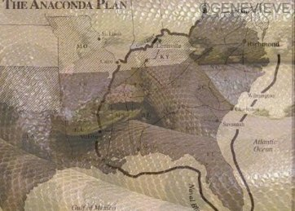

Slide 5
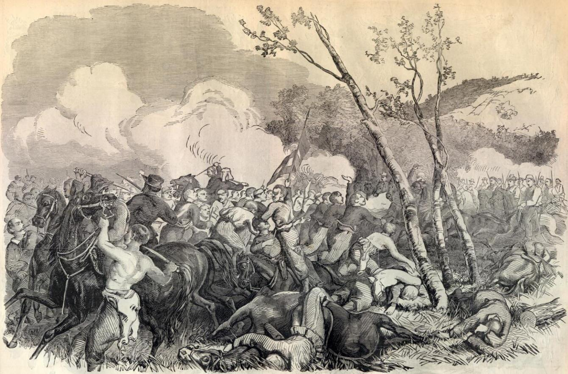
Battle of Bull Run/Manassas – July 1861
1st major battle
Thomas “Stonewall” Jackson led the confeds to victory after his refusal to yield
Lincoln responded by replacing the union commander McDowell with George McClellan
Union: 460 killed, 1,124 wounded, and 1,312 missing or captured; Confederate: 387 killed, 1,582 wounded, and 13 missing.

Slide 6
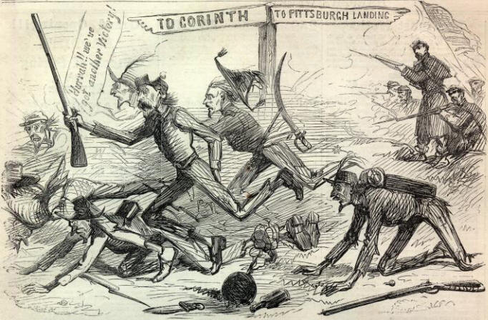
Meanwhile, Ulysses Grant was in the MS valley
He captured two forts (Henry and Donelson) but in April of 62 he fought the Battle of Shiloh in which 25k soldiers were killed or wounded in two days.

Slide 7
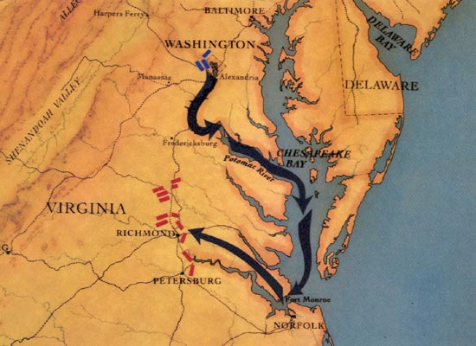
Lincoln wanted McClellan to attack but he was being cautious
McClellan was stopped on his way to Richmond by Lee and Lincoln replaced him.
At the 2nd Battle of Bull Run the union Was defeated again and Lincoln reinstated McClellan

Slide 8
Lincoln needed to address the slavery issue b/c he was getting pressure
He had a plan but he needed a victory to announce it
Battle of Antietam – Sept of 1862, Lee went up into Sharpsburg, MD hoping to attract Northerners to join.
McClellan found out about his plan and attacked.
23k troops died in the bloodiest day of the war and Lee retreated even though the North lost more people

Slide 9
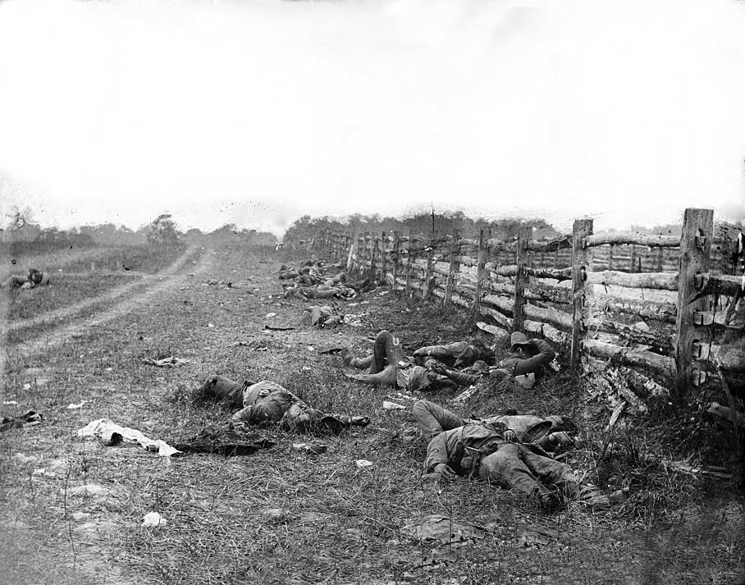

Slide 10
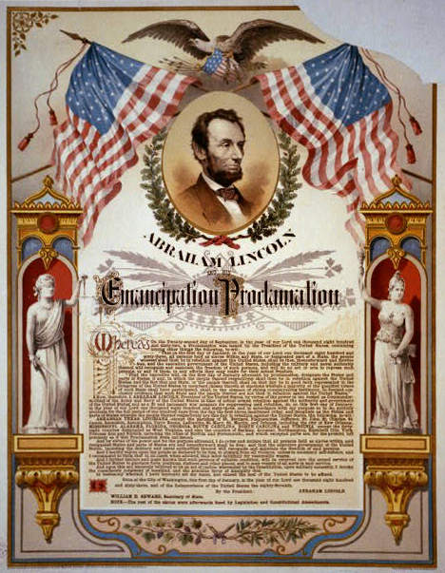
Emancipation Proclamation: Brilliant politics to destroy the South’s Economy
Issued on Sept 22nd, 1862, by Lincoln, it claimed to free all enslaved people in states still in rebellion after 1/1/1863.
Did not apply to border states or states already in Union control or the Union
Douglas liked it, Garrison didn’t
Divided Congress
Made the S more firm in fighting to the end and the N more about fighting for slavery

Slide 11
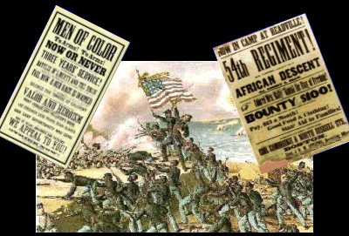
Congress passed the militia act mandating African Americans be accepted into the military
54th MA Regiment
African Americans in the South helped the Union through providing food for Union troops or enlisting; spies and scouts

Slide 12
Life During the War
North used an income tax and sold bonds.
Gov issued some acts
Legal tender act (1862) – gov’t could issue paper currency (greenbacks) b/c they were green…US had a common currency now.
Homestead act – made land in the W available for cheap for farming
Pacific RR Act –let RR co. buy land to build RR through Union territory

Slide 13
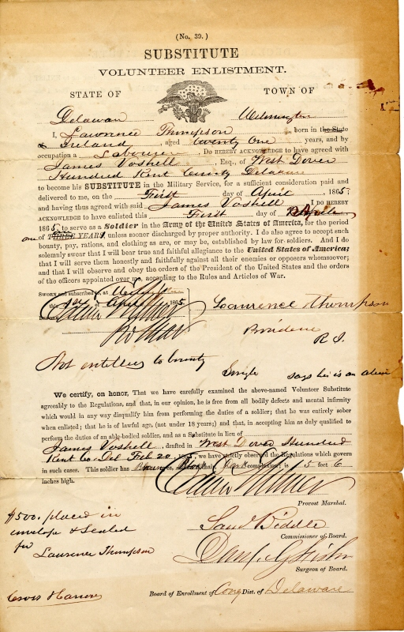
Union started conscription/the draft but you could pay $300 for someone to take your place
This led to the NY Draft riot in 1863
African Americans were counted in the draft so they were targeted.

Slide 14
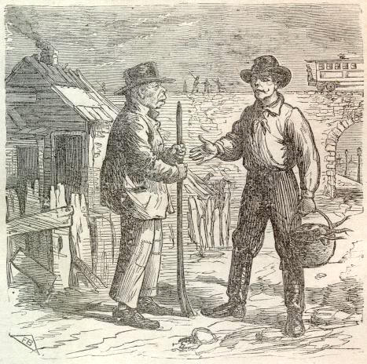
Copperheads – These people were from the N and against the war
In response, Lincoln suspended the right of Habeas Corpus (protection against being jailed w/o being charged)
He told the Army to arrest anyone disloyal to the Union

Slide 15
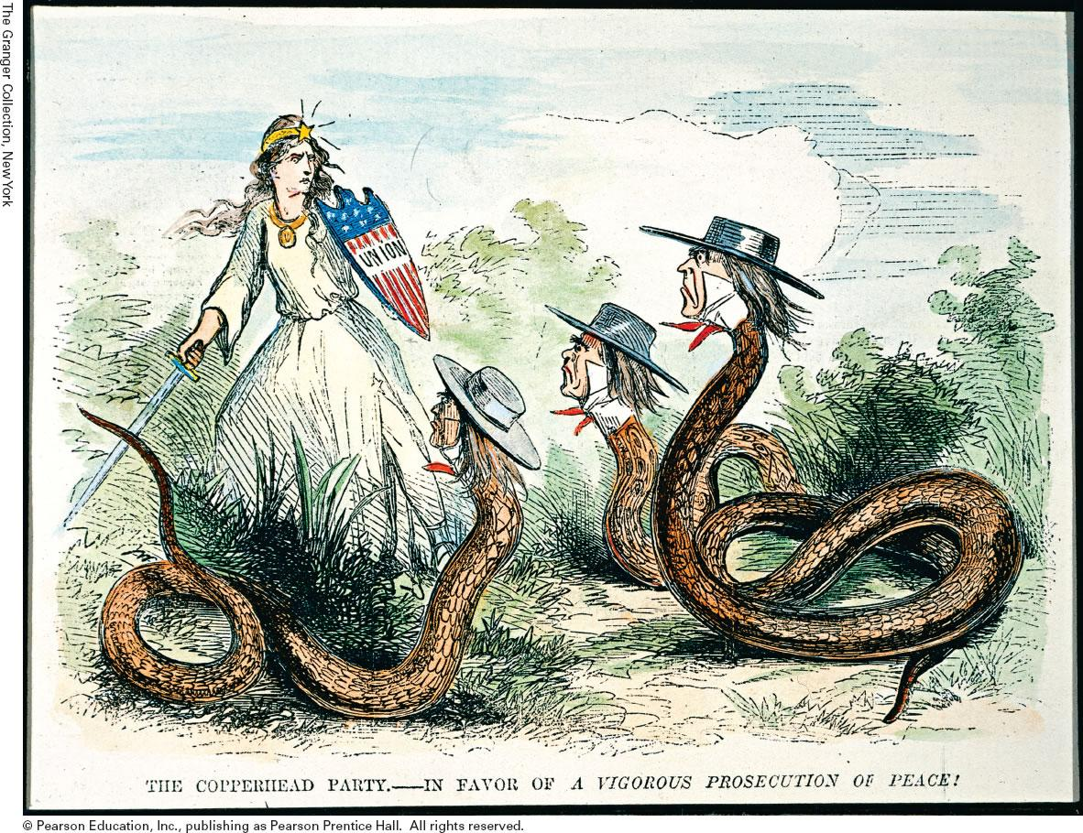

Slide 16
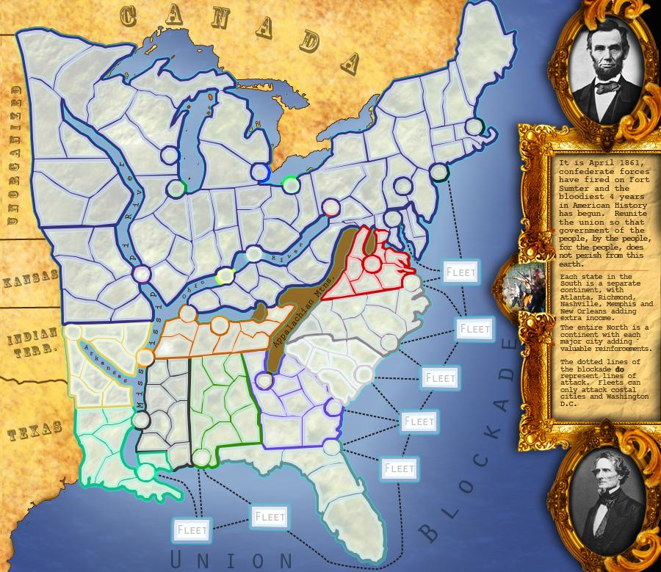
The South
Union blockade was 80% effective so the S couldn’t get supplies
They had trouble paying for the war so they would seize N supplies or take it from the dead
Issued “greybacks” but soon inflation followed
Some states didn’t want their troops to go outside of their state and GA threatened to secede…there were lots of arguments

Slide 17
POWs and Collateral Damage
Many soldiers died from unsanitary conditions
Poor drinking water and lack of sanitation contributed to the death toll
For every one killed in battle, two died of disease
The prison camps were terrible. Andersonville, GA housed 33k and 12k died of hunger
Women helped with sanitation by becoming nurses…Clara Barton got Lincoln to send women along w/troops to help care.
Other women stayed and worked jobs previously done by males...hence female nurses

Slide 18
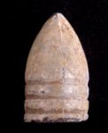
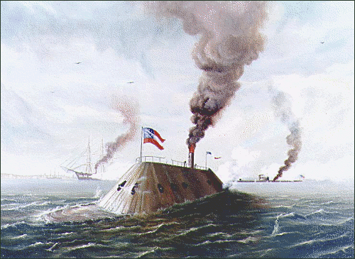
New Technology
Cone shaped bullets
Rifling of the barrel
Repeating rifle – fire 16x’s before reloading
Ironclad ships like the VA (Confed.) and the Monitor (Union)
Start of trench warfare; although this didn’t get really popular until WWI

Slide 19
Seige of Vicksburg
Vicksburg was a S. stronghold and the location made it hard for the N to attack
Grant came up with a plan to get it.
He marched South of Vicksburg and attacked RR to distract the Confeds.
He then headed NE and captured Jackson, MS and cut off the main RR thus cutting off supplies to Vicksburg
He then put Vicksburg under siege for over a month

Slide 20
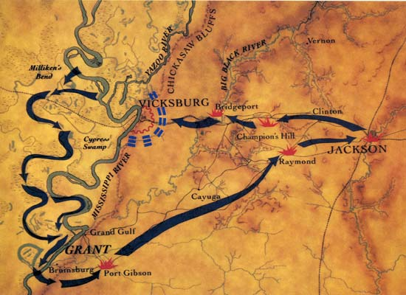
Confeds. surrendered on July 4, 63
Shortly after, Port Hudson, LA surrendered
This was a turning point in the war b/c the Confederacy was cut in two.

Slide 21
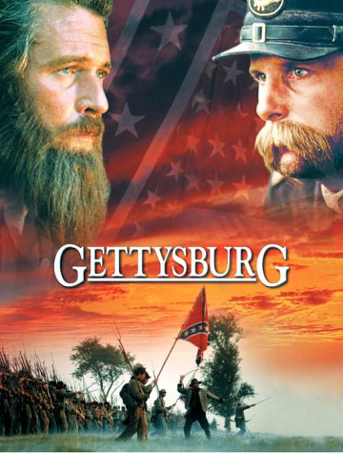
Battle of Gettysburg
Lee had two big victories in battles at Fredericksburg and Chancellorsville (however he lost Stonewall Jackson in the latter).
After this he decided to attack the North again so he headed up to PA in June of 1863

Slide 22
Results of the Battle
The fighting lasted 3 days and 50k were dead or wounded.
1st day – S. pushed the N. back onto higher ground but had to halt fighting b/c of nightfall…this allowed the N. to regroup
2nd – Lee tried to attack both sides of the N. line but the N. still had the high ground at the end of the day
3rd – Lee tried to attack once again but his soldiers were cut down by the Union troops on higher ground
He consequently retreated back to VA and the S. wouldn’t attack the N. again (another big turning pt.)

Slide 23
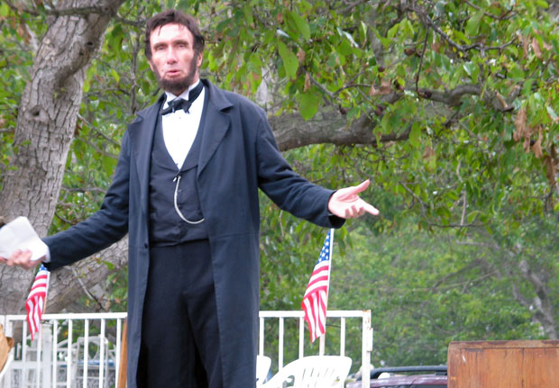
Gettysburg Address
Nov 1863 – Lincoln went to Gettysburg to pay tribute to the fallen soldiers.
In the address he said that the Civil War was to preserve the Declaration of Independence and to make sure all men were created equal

Slide 25
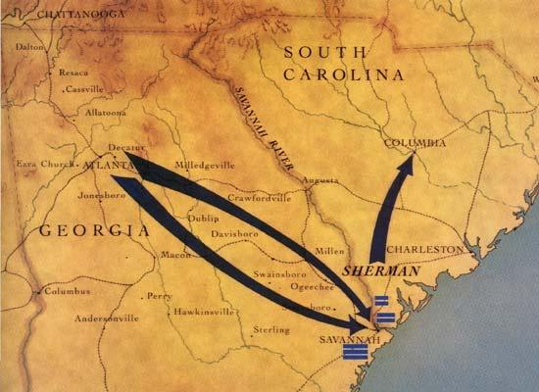
Total War
This was when the N. tried to destroy the S. in every way – civilians, homes, business’s
General Grant did this in VA against Lee as he was trying to take Richmond
William Sherman did this on his March to the Sea where he took 60k troops to take over Savannah
On his way, he took Atlanta and burnt it to the ground
Then he went on to do twice the damage to SC

Slide 26
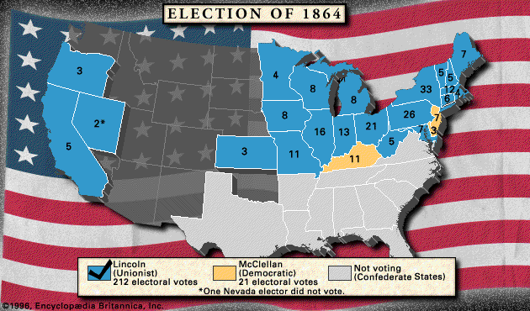
Election of 1864
Union commander George McClellan was picked by the (D)
He got 45% of the vote but Lincoln still won w/ 212/233 electoral votes
This destroyed the Confeds. hopes of the North ever giving up.

Slide 27
Grant wanted Richmond but got stopped at Petersburg by Lee, a Southern RR center.
For months –summer of 1864 until march of 1865, they fought however the N. had replacement soldiers whereas the S. didn’t.
Lee retreated and Richmond was burnt to the ground
but not by the north
Lee tried to flee to NC but was trapped at Appomattox Court House, VA and surrendered on April 9^{th,} 1865
It took a couple months before the rest of the Confeds. got the news but the war was over

Slide 28
Assassination of Lincoln
April 14th @ Ford’s theatre John Wilkes Booth shot Lincoln in the head
He died the next morning
Booth had been part of a plot to kill Lincoln, VP and Sec of St
Lincoln’s death further united the North

Slide 29
Impact of the war
13th Amendment – Outlawed slavery, proposed in Feb of 1865, ratified in Dec 1865. South came to peace talks and was annoyed by it.
Economy – North was prospering and went through another industrialization. Gov gave money to set up colleges from land purchases and used tariffs. The South was in shambles.
Politically it reasserted the power of the fed gov’t...no more state’s rights as an issue...we are a union of people, not of states...therefore a state cannot leave the union when it wants...this will never be an issue again for America to fight over

Slide 30
