Slide 1
Chapter 6
The Union in Crisis
1846-1861

Slide 2
North vs South
Industrialized, cities, immigrants
Laws limited African Americans freedoms and discouraged migration
Abolitionists
Some got rich off of slavery b/c they sold cotton clothes or didn’t want competition for jobs
For Wilmot Proviso – banned slavery in the territories
Agricultural, based on cotton, slavery
Slavery was extremely important to economy
Argued northern free labor system harmed society and that slaves were happier then northern workers
Against Wilmot Proviso

Slide 3
Election of 1848
Wilmot Proviso caused several groups to form the Free Soil Party – they pledged, ‘Free soil, free speech, free labor, and free men. They wanted to keep slavery out of the (W) territories
They nominated Van Buren, (D) nominated Lewis Cass from MI who opposed the WP and Whigs nominated Zachary Taylor who was a slaveholder from LA.
(D) and (W) proclaimed popular sovereignty – voters should decided on the issue of slavery, not Congress
Taylor won but the FSP brought slavery more into the limelight

Slide 4
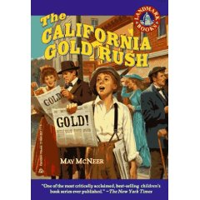
Tensions between the N and S
People flooded CA b/c of gold and now they needed laws.
Wanted to be a free state and (S) was mad
TX and Gov were disputing over Northwestern border
NM + UT b/c territories and might join as free
Slavery in DC was an issue
Fugitive Slave Law 1793

Slide 5
Compromise of 1850
Clay came up with this 1) CA would enter as free st 2)NM and UT would decide slavery on pop sovereignty 3) Slave trade/not slavery, would end in DC 4)New strict Fugitive slave law (private citizens had to assist w/runaway slaves and u could be fined or imprisoned for helping a slave) 5)TX would get $10 mil for NM
It passed the Senate but there was a lot of disgust from both sides.
Calhoun and Pres Taylor were not huge fans but they both died and Millard Fillmore as Pres took over and he liked it

Slide 6
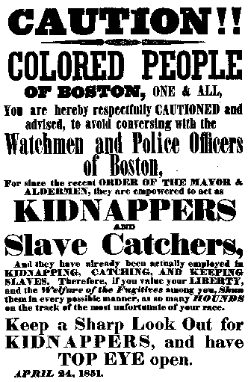
(N) was mad about the Fugitive Slave Acts b/c they thought they were being forced to support slavery.
Several states passed personal liberty laws which nullified the FSA and allowed states to arrest slave catchers.

Slide 7
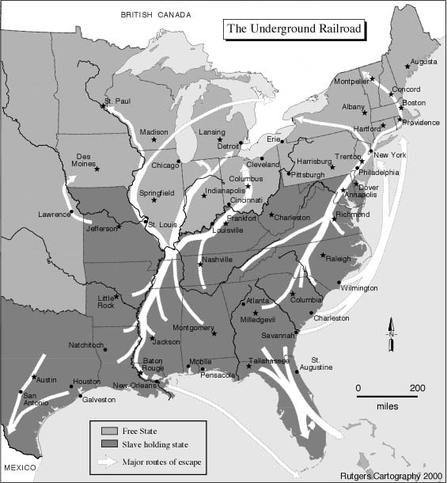
Underground Railroad
A network of abolitionists and free blacks who would sneak slaves out of the (S) in wagons, boats…
Harriet Tubman – nicknamed ‘Black Moses’ she led about 24 trips into the (S) to lead people out.
A reward was put out for her capture

Slide 8
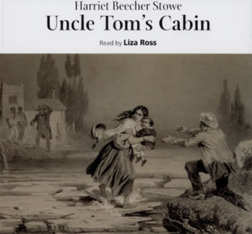
Harriet Beecher Stowe
She wrote Uncle Tom’s Cabin in 1852
It showed the horrors of slavery; 300K copies sold
The (S) was mad and published books in which slaves were happy.
"So you’re the little lady whose book started the Civil War."

Slide 9
Kansas-Nebraska Act
This act was proposed by Senator Douglas from IL and he wanted KA and NE territory to decide about slavery by pop sovereignty…the hope was that KA would be a slave state and NE free
This cancelled the MO Comp which had not allowed slavery for 30 yrs.
Pro and Anti slavery people poured into KA to get it set up their way
Some of the pro slavery people from MO were called Border Ruffians

Slide 10
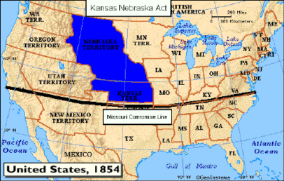
5/21/56, Ruffians hit the antislavery town of Lawrence KA
John Brown, a NY abolitionist executed 5 proslavery settlers in retaliation
Violence now went wild and the area b/c known as Bleeding KA

Slide 11
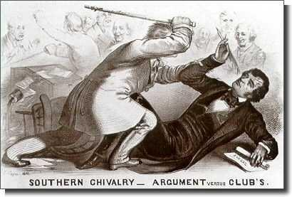
Brook-Sumner Incident
Violence also spilled over into the Senate
Charles Sumner of MA shunned the South and their conduct in KA
He insulted Andrew Butler of SC and Butler’s nephew, Preston Brooks, beat him with a cane
Brooks quit but the voters voted him back

Slide 12
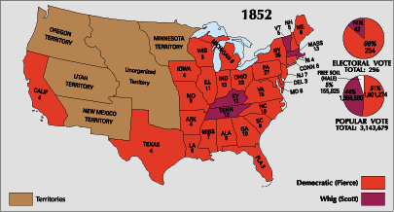
The Whigs went faded after the election of 1852 b/c Millard Fillmore was in favor of CA coming in as a free state and the Fugitive Slave Act.
The former made the (S) mad and the latter made the (N) mad.
People left their party after this.

Slide 13
As the Whigs were going out, the Know Nothings/American Party (nativism) were created. They were against immigrants but soon they were divided over slavery as well.
In 1854, The Republican Party was created. They mainly opposed slavery and the KA-NE act. They were joined by breakaway members from all the groups and businessmen who thought slavery got in the way of industry.

Slide 14
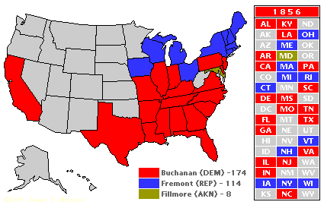
Election of 1856
(D) James Buchanan of PA won by promising he would stop the slavery issue
The R had a strong showing w/ John Fremont and campaigned for KA to be a free state, no slavery in W and no pop sovereignty

Slide 15
Dred Scott v. Sanford 1857
Scott was a slave who had been taken to the free state of IL and WI and so he sued for his freedom based on the MO Comp.
Court ruled that slaves were property and not citizens so he couldn’t use the courts and the MO comp was unconstitutional b/c you can’t deprive someone of property w/o due process

Slide 16
Lincoln-Douglas Debate
Abraham Lincoln and Stephen Douglas argued in 1858 while competing for a Senate seat.
Douglas (D) backed popular sovereignty, the annexation of TX but people didn’t know if he was self-serving
Lincoln (R ) said the Dred Scott case was wrong, attacked pop sovereignty and condemned slavery (although he didn’t think African Americans should be equal)
Douglas won the election but Lincoln got a nat’l following.

Slide 17
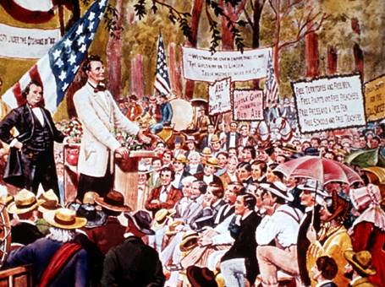
Freeport Doctrine (Issued by Douglas during debates)
He stated that slavery could be barred from the territories if the territorial legislation refused to enact the type of policy to make slavery work...w/o a legal framework slavery would be excluded.
Douglas' statement enabled him to retain his Senate seat, but it split the (D) Party and lost support he had in the south

Slide 18
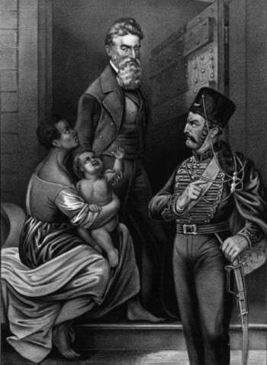
John Brown at Harper’s Ferry
Brown thought he was an angel of God, avenging slavery and violence was the answer.
In 1859 he got 21 men to storm the arsenal at Harpers Ferry, VA (now WV) in the hopes others would join.
It didn’t work and he was put to death
It further split the nation, Lincoln condemned him but the South still didn’t like it.

Slide 19
Election of 1860
Lincoln (R ) – End to slavery in the territories but there would be no interfence w/ states that already had it.
Douglas (Northern D) – Popular Sovereignty
Bell (Whigs) – condemned sectionalism and promoted the constitution
Breckinridge – (Southern D) – Federal protection of slavery in the territories
Lincoln won but he didn’t receive one electoral vote from the South b/c he wasn’t on the ballots

Slide 20
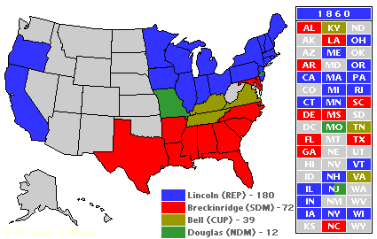

Slide 21
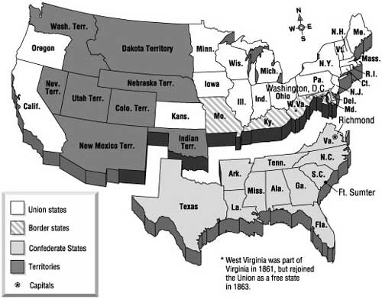
SC seceded from the Union on 12/20/1860 saying that the Lincoln was hostile to slavery.
6 other states followed
In Feb 1861, they formed the Confederate States of America, framed a constitution w/ the right to secede and protection of slavery in it and chose Jefferson Davis (former MS Senator) as Pres.

Slide 22
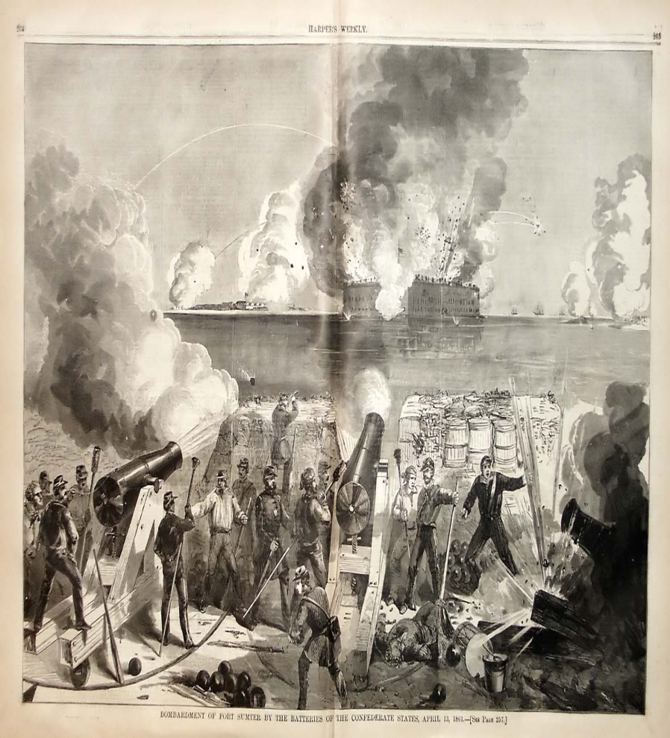
Fort Sumter
Lincoln took office on 3/4/61 and pledged to protect slavery where it existed, preserve the union and to not start a war unless the (S) did.
He had to decide what to do about the federal fort that was now on Confederate territory.

Slide 23
A War...A War Down South In Dixie
Buchanan had sent supplies but the (S) fired on the ships.
Lincoln had said he wouldn’t attack the (S) but he thought he had to protect gov’t property…he decided to just send supplies
(S) ordered the surrender and the northern troops refused so the Confederates fired. The Union troops ran out of ammo and had to surrender.
As a result, Lincoln called for 75k volunteer soldiers and the S called for volunteers as well
VA, AK, TN, NC broke away and joined Confederacy
The Civil War had begun

