Slide 1
Unit 8: Economics 2
Problems, Policy, and The Fed

Slide 2
Problems & Resolutions

Slide 3
Monetary & Fiscal Policy
Monetary policy – policy that controls the $ supply; changes in $ supply to stabilize prices, employment & econ growth
Controlled by the Federal Reserve “The Fed”
Fiscal Policy – changes in govt spending or taxes to help stabilize & grown the economy
Controlled by the federal govt

Slide 4
The Federal Reserve System
Called the Fed – set up 1913/14
Created to stop bank failures due to running out of money & regulate banks
banks must keep certain amt of $ in reserve
US divided into 12 federal districts w/ Federal Reserve bank in each
Fed banks work only with govt & other banks

Slide 5
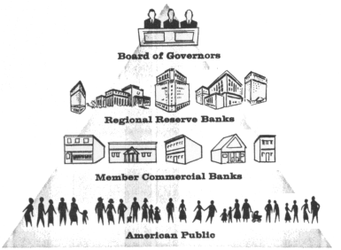
The Federal Reserve System
Purpose – government banking & control nation’s $ supply
7-member board of governors in D.C.
Appointed by president / approved by Senate
Serves 14 years

