Slide 1
Goal 7: Economics
The Business Cycle

Slide 2
Business Cycle
The business cycle is economic pattern where econ goes through good and bad times
Common in free markets
Phases of the BC:
Recovery/expansion: general increase in bus. act.
Peak/boom: economy operating at high level
Contraction: general decline in business activity
Recession: economy in decline for a per. of 6 mo

Slide 3
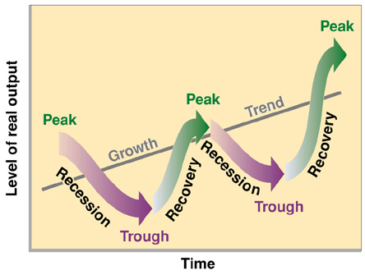
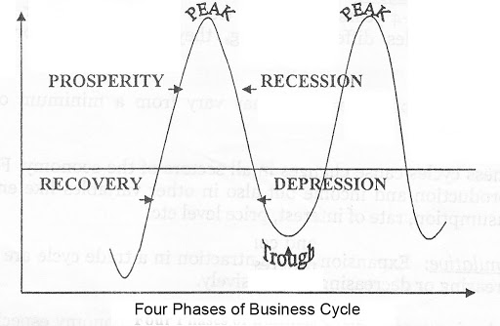
Business Cycle
Phases continued…
Trough: economy at lowest point; it’ll begin expansion
Depression: extended period of contraction; very low trough w/ very high unemployment

Slide 4
Business Cycle & Economic Probs
When economy booming the Gross Domestic Product (GDP) increases
GDP = total amt of goods/services produced by the country in 1 year
Economic problems:
Inflation: rise in the price/costs of goods/services
Costs of doing bus/cost of production goes up and prices rise as a result

Slide 5
The Great Depression
Probs began Oct. 1929 w/ stock market crash
Banks failed
Ppl lost savings
Decline in production
Businesses closed
Farms fail
High unemployment
High home loss
Lasted 10 years

Slide 6
Government Response
Govt stepped in to create more jobs / fix econ
FDR – the New Deal
WPA: Works Project Administration
FDIC
SEC
Social Security System

Slide 7
Predicting the Business Cycle
3 types of indicators:
Leading – helps to make predictions about future of economy & come before major changes in bc
Ex: increase in # of building permits
Coincident – shows how econ is doing at present time & tells if upturn or downturn is coming
Ex: if there’s an income in ppl’s income
Lagging – helps determine how long current phase of bc will last & comes after major changes in bc
Ex: increase in new businesses

