Slide 1
Unit 7: Economics
Production / Goods & Services

Slide 2
Decisions
Trade-offs: alternative you have to face when making a decision
Opportunity cost – the value of choosing one thing over the other
Ex: living in the city vs. living in the country
Cost-benefit analysis - Economic model that compares the costs and benefits of a decision

Slide 3
Goods & Services
Goods – physical products; things made/manufactured for ppl to buy/own
Food, cars, buildings, television
Services – not physical objects; things ppl do
Doctors, translators, tutors, painters, mechanic
Combination
House painter, restaurant

Slide 4
Goods & Services
Productivity - The degree to which resources are being used efficiently to produce goods and services
Specialization - When people, businesses, regions and/or nations concentrate on goods/services that they can produce better than anyone else

Slide 5
Goods & Services
Types of services:
Personal – performed on consumers
Medical, hair, fitness…
Repair – performed on goods that you own
Mechanic, heating & cooling…
Other – retail services, entertainment services, banking, legal

Slide 6
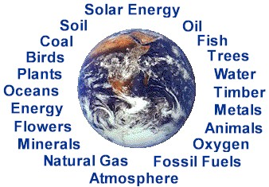
Factors of Production
Key questions of production:
1) What to produce?
2) How to produce?
3) For whom are we producing?
4 factors of production:
Natural resources
Capital
Labor
Entrepreneurship
Questions help to decide how to use the 4 factors

Slide 7
Factors of Production
Natural resources – things provided by nature w/out human intervention
Ex: land, animals, water, minerals, timber, etc.
Many limited
Factor of production only when pay for use
Capital – equipment used to make other goods/services
Ex: tools, trucks, machines, etc. (capital goods)
There is also financial capital - $ used to buy the tools/equipment
Get from loans, investors, stock

Slide 8
Factors of Production
Labor – all human effort, skills, & abilities to produce goods/services
Usually refers to workers
Paid – hourly vs. salary
Entrepreneur – person who organizes & manages the factors of production for creating a business
Make important contributions to economy

Slide 9
Government’s Role
Regulates competition by outlawing monopolies
Provides information to business owners to use in planning
Census, statistics
Protects workers’ health & safety – OSHA
Protects consumers
Protects environment – pollution from businesses

