Slide 1
Goal 7: Economics & Choices
US Economy

Slide 2
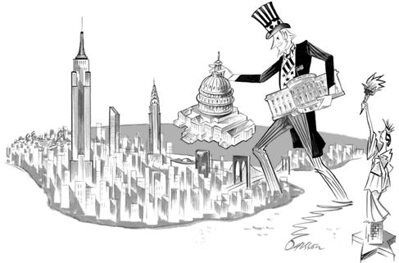
US Economic System
The US is a market/mixed economy
Market economy also called capitalism
Has free enterprise system – individuals & businesses compete for profit w/ minimum govt interference

Slide 3
Goals & Characteristics of the US Econ
Goals:
Provide jobs
Efficient use of resources
Continued economic growth
Equal access to jobs & education
Characteristics:
Private property
Profit incentive
Competition
Freedom of choice
Limited govt involvement

Slide 4
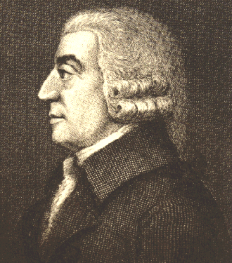
Adam Smith’s Ideas
Wrote “Wealth of Nations”
Provided basic outline of econ theories in market economy
Invisible hand: supply, demand, competition will help to regulate a free market
Laissez Faire: govt shouldn’t interfere w/ economy

Slide 5
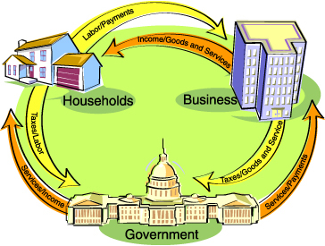
Circular Flow

