Slide 1
Unit 4: Law & the Legal Sys
Crime in the United States

Slide 2
Types of Crime
Crime = any act that breaks the law & has punishment
Criminal = person who commits crimes
Felonies = serious crimes
Ex: murder & kidnapping
Misdemeanors = less serious crimes
Ex: traffic violations & disturbing the peace

Slide 3
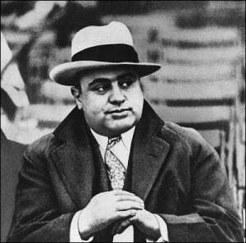
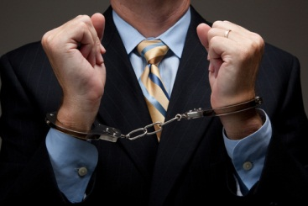
Types of Crime
5 main categories of crimes:
Crimes against persons
Crimes against property
Victimless crimes
White-collar crimes
Organized crimes

Slide 4
Types of Crime
Crimes against persons: violent crimes that include force or threat of force
Homicide (murder)
Hate crimes
Aggravated assault (most common)
Sexual assault or rape

Slide 5
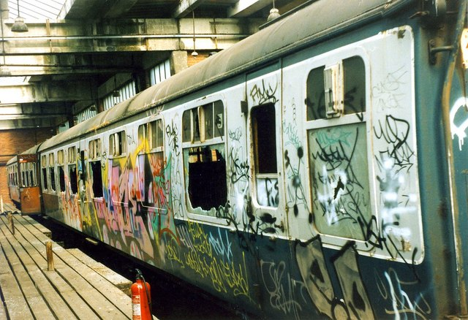
Types of Crime
Crime against property: stealing/destroying
Majority of crimes
Larceny & car theft
Vandalism
Arson
Robbery – ppl

Slide 6
Types of Crime
Hate crimes – violent crimes committed bc of prejudice
Victimless – other ppls rights not violated
Ex: illegal gambling & use of illegal drugs
White-collar – committed by ppl in their work
Ex: fraud, embezzlement, cybercrime, identity theft…
Organized – crime group of career criminals
Illegal goods/services, gambling, drugs, prostitution
Threats of violence

Slide 7
Causes of Crime
Poverty: associated w/ unemployment
Illegal drug use: need to support habit
Permissive society: kids growing up w/out rules
Urbanization: more ppl & younger ppl
Other: technology, social change, education, lack of $ in govt

Slide 8
Fighting Crime in the US
1994 – National crime bill passed
Tougher sentences
$ for new jails & more police
Crime prevention
Sometimes taught in schools
Citizens can help to fight crime
How????

