Slide 1
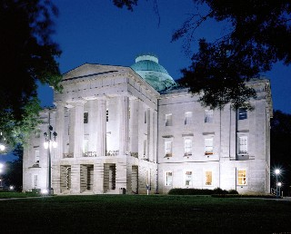

North Carolina State and Local Government

Slide 2
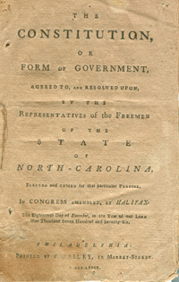
The North Carolina State Constitution
The first North Carolina Constitution was adopted in 1776
A new Constitution was adopted in 1868
Our current Constitution was adopted in 1970
  Simplified the text
  Ended segregation in schools

Slide 3
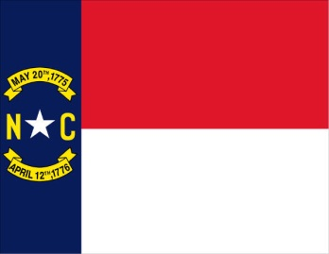
The North Carolina State Constitution
Purpose
  Establishes govt of North Carolina
Declaration of Rights
  Article 1: List of individual rights
Similarities to the U.S. Constitution
  Separation of powers, checks and balances, popular sovereignty
Amendments to the NC Constitution
  Lowering voting age, two term governor, veto power, impeaching powers

Slide 4
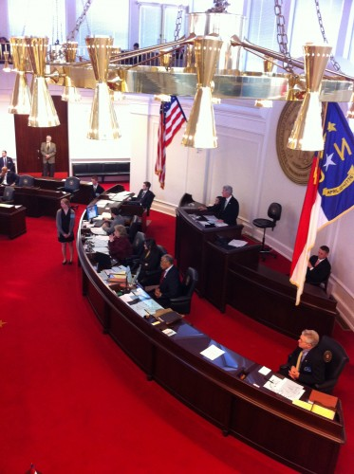
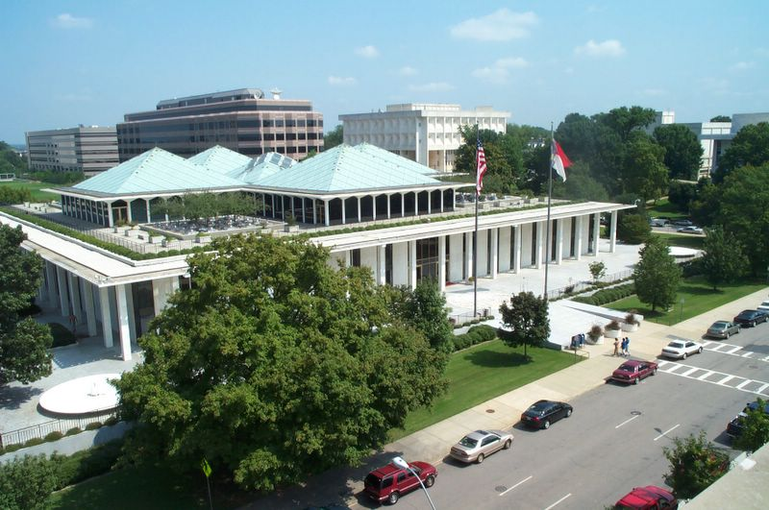
Legislative Branch
North Carolina General Assembly
  Bicameral
    House of Representatives (120) and Senate (50)
Requirements to Run
  House: 21 years old; one year in district
  Senate: 25 years old; 2 yrs. in NC, 1 in district
Responsibilities
  Pass laws (statutes), passing budget, elect college board members

Slide 5
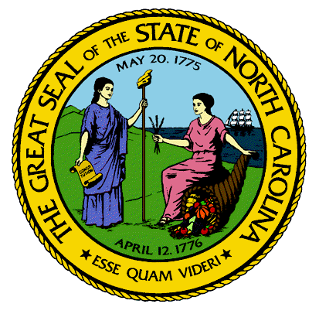
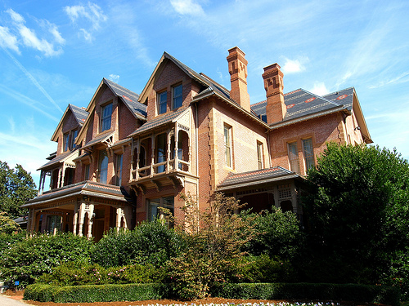
The Executive Branch
The Governor
  Similar powers to the President
The Lieutenant Governor
  Similar to Vice President
The Council of State
  Elected officials
The Governor’s Cabinet
  Similar to the President’s Cabinet

Slide 6
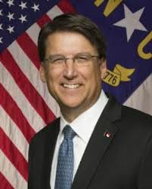
The Governor
4 Year Term (limit of two)
30 years old, 2 year resident of North Carolina
Powers and Responsibilities
  Appoints officials
  Proposes legislation
  Proposes/administers state budget
  Veto legislation
  Grant clemency (pardons)
Gov. Pat McCrory (R)

Slide 7
The Lieutenant Governor
4 Year term
  Elected independently from the Governor
Duties
  Succeeds Governor if necessary
  President of the Senate
    Only votes to break ties
  Serves on committees and boards for the state

Slide 8
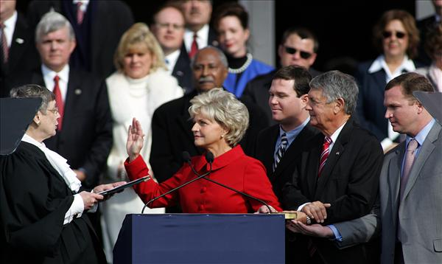
The Council of State
10 people, all elected for four year terms by the people of North Carolina
  Governor and Lt. Governor
  Attorney General, Commissioners of Agriculture, Insurance, and Labor, Sec. of State, State Auditor and Treasurer, and Superintendent of Public Instruction
The Council of State all work independently

Slide 9
The Governor’s Cabinet
10 Departments appointed by the Governor
Departments of:
  Administration
  Commerce
  Correction
  Crime and Public Safety
  Cultural Resources
  Environment and Natural Resources
  HHS
  Juvenile Justice
  Revenue
  Transportation

Slide 10
The State Judicial Branch
NC Supreme Court
Court of Appeals
Superior Courts
District Courts
North Carolina Court System

Slide 11
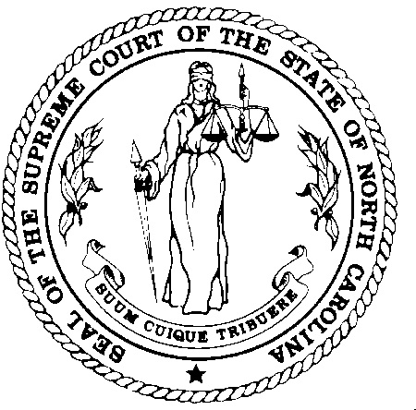
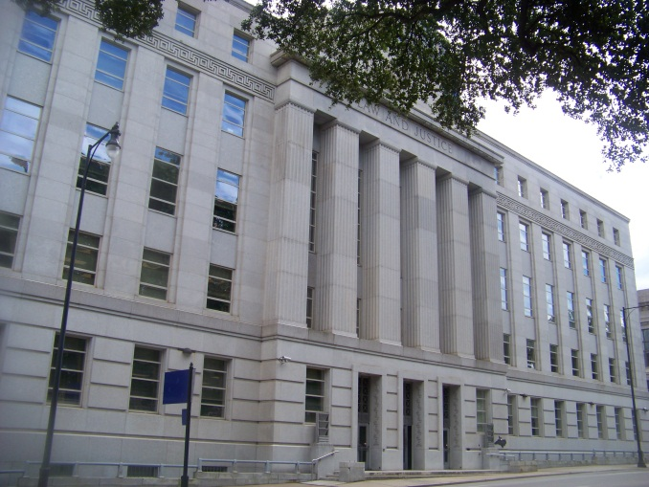
The Judicial Branch
Jurisdiction: cases involving state law- criminal and civil
  Original
    District: misdemeanors and small civil cases
    Superior: felonies and big civil cases
  Appellate
    State Appellate Court
    State Supreme Court

Slide 12
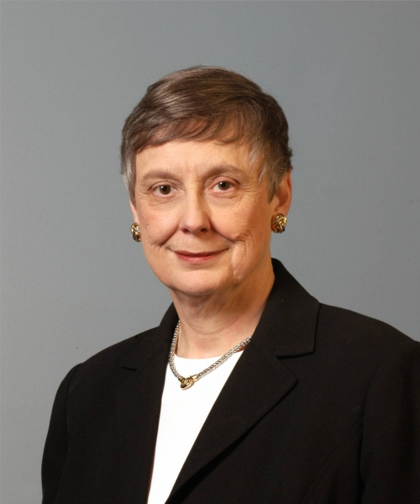
The Judicial Branch
State Judges
  Judges in North Carolina are elected by the people
  Magistrates
    Perform preliminary proceedings, but they are not judges
  Supreme Court
    Chief Justice and Six Associate judges
    Elected for 8 year terms
Sarah Parker
Chief Justice
NC State Supreme Court

Slide 13
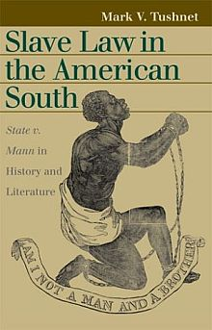
Landmark State Supreme Court Cases
State of North Carolina v. Mann (1830)
  Ruled that slavery was legal
  State Constitution is the supreme law of the state
Leandro v. State of North Carolina (1994)
  Ruled that all children in NC have the right to a basic quality education

Slide 14

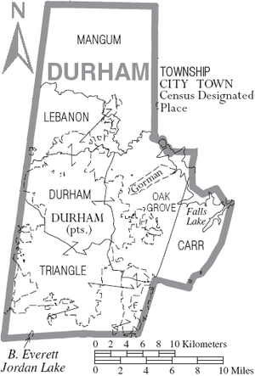
Local Government
County Government
Municipal Government

Slide 15
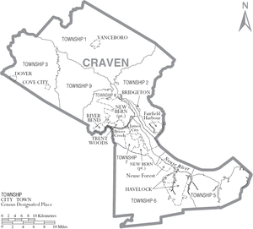
County Government
There are 100 counties in NC
  Craven: 104,786 in 2008
Run by:
  Elected County Commissioners
    Manage budget
    Levy taxes
  CCs hire a County Manager
    Oversees day to day operation of the county

Slide 16
Other Elected County Officials
Sheriff
  Provides law enforcement for ‘unincorporated’ parts of the county
  Maintains county jails
Board of Education
  Sets budgets
  Hires administrators
  Textbook decisions
  Sets school calendar

Slide 17
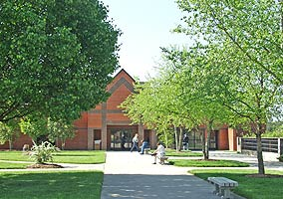
Services Provided by Counties
Community Colleges
Courts
  County Courthouse
Jails
  Overseen by the Sheriff
Soil and Water conservation
  Clean water, solid waste management

Slide 18
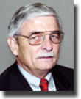
Municipal Government
Municipality:
  ‘Incorporated’ city or town
  Havelock: population of 20,966(2011)
Governed by:
  Mayor
    Elected (Jimmy Sanders)
  City Council
    Elected
  City Manager
    Hired by City Council
Mayor Jimmy Sanders

Slide 19
Responsibilities of City Government
Mayor
  Presides over council meetings, leads council
City Council
  Prepares budget, passes municipal laws (ordinances)
City Manager
  Runs the city day to day
  Hires and Fires city employees
  Advises the Council

Slide 20
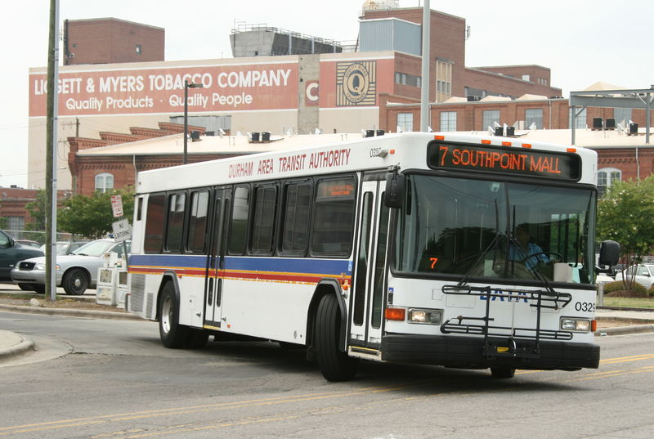


Services provided by cities
Public transportation
Police Protection
Public Housing
Public Utilities
  Electricity, gas, cable, telephone
Libraries
Parks and Recreation
  Parks, community centers

Slide 21
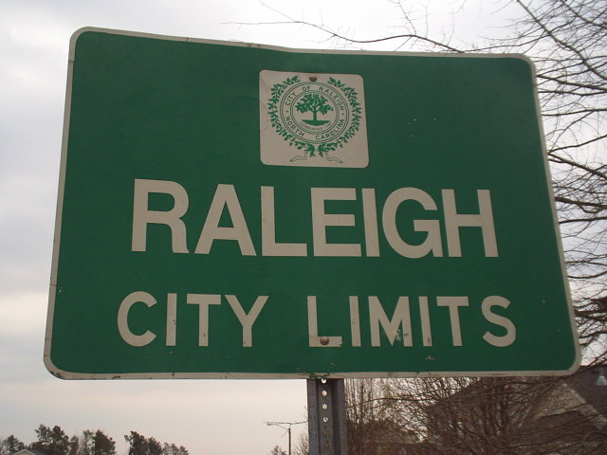
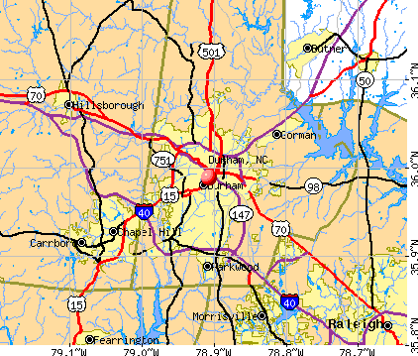
Where do cities come from?
When ppl who have settled in unincorporated area want to est a city, they ask the General Assembly to become incorporated
  Creates city services
  Establishes geographic boundaries
Once incorporated, the town creates a charter
  document that gives a city or town authority & est how it will be governed

Slide 22
Towns & Townships
Town – larger than village/smaller than city
  Some hold town meetings – form of local govt; ppl meet to discuss & vote
Townships – smaller unit of govt not in all states
Special districts – unit of govt used to meet certain needs
  Ex: school districts

Slide 23
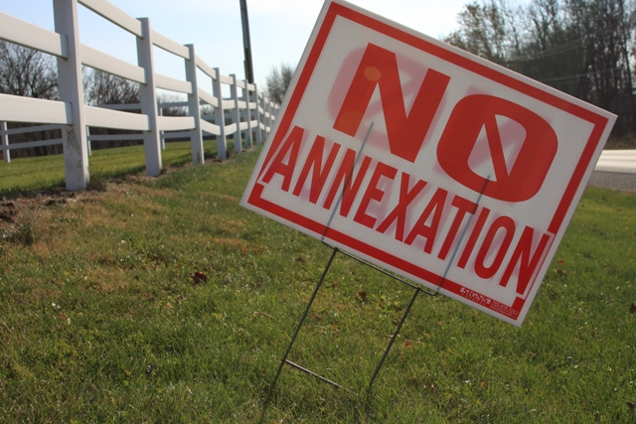
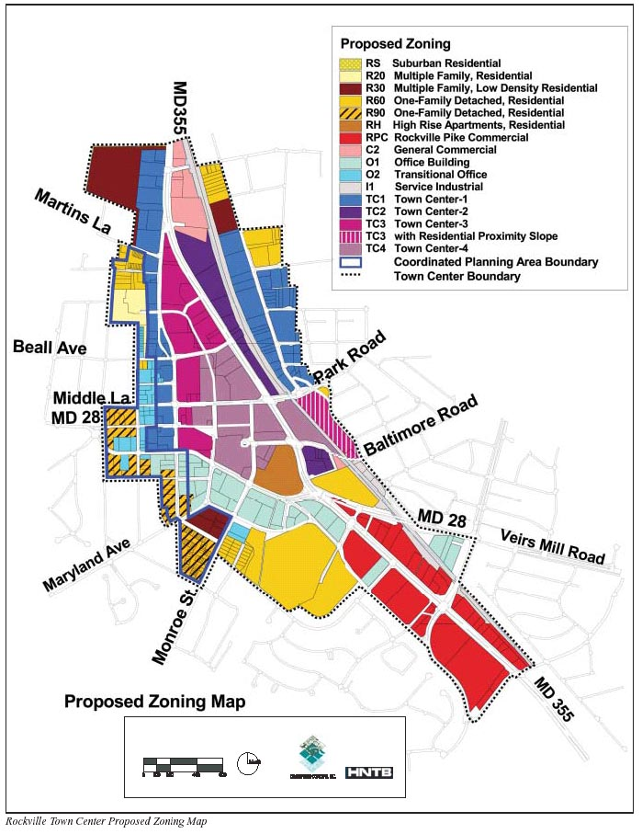
Issues facing cities
Zoning
Annexation

Slide 24
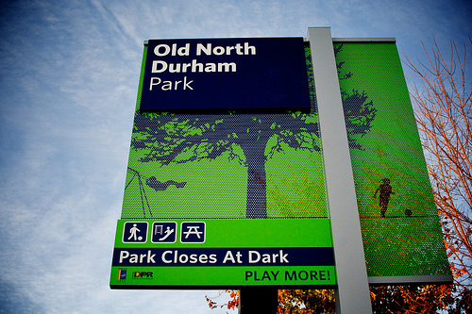
Zoning
City Councils decide purpose of land in a city
Zoning restrictions
  Ex: no liquor stores within 500 yards of a school
Typical zoning areas:
  Residential
  Business
  Mixed Use
  Green space

Slide 25


Annexation: when a city extends its boundaries to take in people living in unincorporated areas
Pros:
  New residents get services provided by the city
    Police & Fire protection
    Water
    Waste removal
    Sewer
Cons
  Taxes go up
    City services cost $$$
  New laws and regulations to live by
    City ordinances take effect

Slide 26
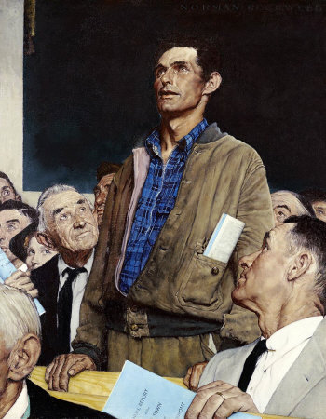
Civic Participation
Voting
Petitioning
Participating in public hearings
  Public hearings give citizens the chance to speak and express opinions about an issue

Slide 27
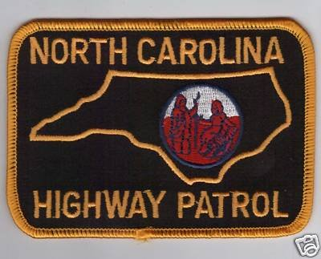

State and Local Law Enforcement
State Police
  Protect interstate highways and assisting motorists
  State Troopers
County Police
  Enforce laws in unincorporated parts of the county
  Sheriff
City Police
  Enforce laws in city limits
  Provide security services
  Chief of Police

Slide 28
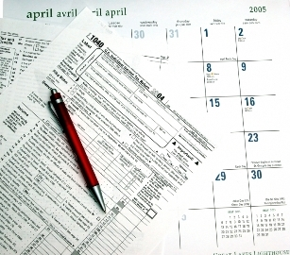
Financing State and Local Government
Where does the state get money for its budget?
  Individual Income Tax +/- 50%
  Sales Tax +/- 28%
  Other Taxes +/- 9%
  Corporate Income tax +/- 5.5%
  Non tax revenue +/- 4%
  Special Funds +/- 3%

Slide 29
What does the state spend its money on?
Education: 58%
  K-12: 40% Colleges: 18%
Health and Human Services: 25%
  Medicaid, Public Health
Justice and Public Safety: 11%
  Corrections, Juvenile Justice, Public Safety
Other: 2%

Slide 30
Financing County Government
Where do counties get their money?

Slide 31
What do counties spend their money on?
Education: 29%
Human Services: 28%
  Medicaid, foster care, hospitals, job training, housing, mental health
Public Safety: 13%
  Sheriff’s, EMS, Fire
Other: 13%
  Parks and Rec, solid waste, libraries
Debt: 9%
General: 8%
  Elections, legal, salaries and wages, etc.

Slide 32
Issues in Education
Budgets
  As tax revenues shrink, so does the $$ available for education
Public Policies
  Schools not meeting federal standards can be taken over by state governments
Non-educational issues
  Violence, family issues, drop out issues, drugs

Slide 33
What are alternatives to the current system?
Charter Schools ~ public schools not held to same regs as normal public schools; private businesses & individuals often pay the cost
Tuition Vouchers ~ government money order so low-income parents can send kids to school of their choice

