Slide 1
Unit 2: Govt Sys & Politics
2 Party System

Slide 2
Political Parties
Political party – grp of citizens w/ similar views on public issues who work to put ideas into govt
PP nominate (select) candidates to run for political office
Candidate – person who runs for govt office
5 functions of PPs:
Campaigning for candidates – help politicians get elected
Informing citizens – give info ~ issues & how govt operates
Help manage govt – appoint local members to certain jobs
Linking diff levels – provide link btwn local, state, & federal govt
Watchdog – alert public of wrongdoing

Slide 3
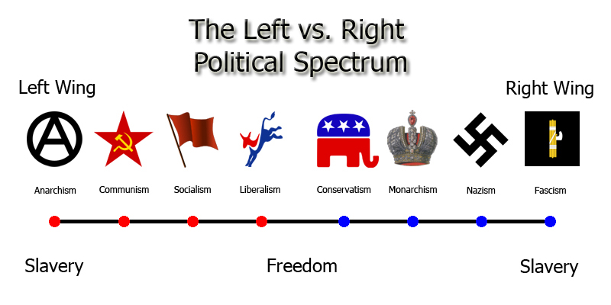
Political Parties
Often labeled “liberal” or “conservative”
Placed on political spectrum – differences in political views held by different political parties

Slide 4
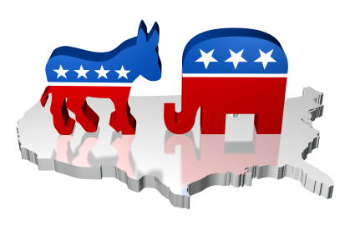
Party Systems
The U.S. has a two-party system: 2 main PPs
System where 2 major PPs battle for control of govt
Ex: U.S. = Democrats & Republicans
One-party system: only 1 major PP; voters have no choice; PPs usually forbidden
Dictatorships or totalitarian govts
Ex: Communism – China, North Korea, Cuba
Multi-party system: 3+ strong PPs fighting for govt control
often have to compromise/work together: coalition: agreement btwn 2+ PP to work together to run govt
Ex: France, Germany, England

Slide 5
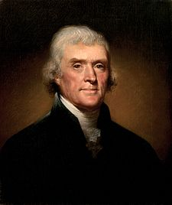
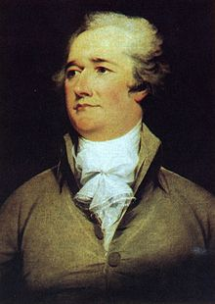
History of Political Parties
Democratic-Republican Party – Thomas Jefferson
Wanted to limit power of fed govt & give more power to state govts
Federalist Party – Alexander Hamilton
Wanted strong national govt to protect ppls rights & solve probs created by weak govt under Articles of Confed

Slide 6
Democrats & Republicans
Democratic Party (Democrats):
more liberal & more govt involvement
Govt must be active in solving social problems
Usually = bigger govt, increased taxes, more change
Republican Party (Republicans):
more conservative & less govt involvement
Less change, less taxes on rich, less govt spending
Social probs will be solved w/ less govt
Social programs created/run by state & local govts & nongovt organizations

Slide 7
Third Parties
Minor PPs in a 2 party system – third parties
Not enough following to compete/win national elections
Offer alternative to major parties; have influence on laws & election outcomes

Slide 8
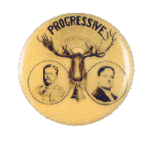
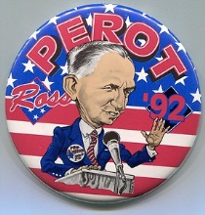
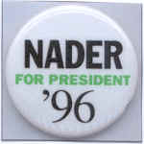
Third Parties
1912: Theodore Roosevelt: Progressive Party
1992: Ross Perot: United We Stand America, Reform
1996: Ralph Nader: Green, Independent

