Slide 1
The Nation Expands

Slide 2
Lewis & Clark Expedition 1
Jefferson had ordered expedition even before US bought Louisiana Territory
“Corps of Discovery” launched from Pittsburgh in August 1804
33 men, 32 of whom survived
Gathered samples of minerals, plants, and animals
Reached Pacific Ocean in December 1805
Returned to St. Louis in September 1806

Slide 3
The Oregon Trail 10
Lewis & Clark’s and Pike’s expeditions opened the way for American settlers to move to the Pacific coast
Between 1840s and late 1860s, tens of thousands of settlers traveled the Oregon Trail (and others)
Went into disuse once railroads became extensive

Slide 4
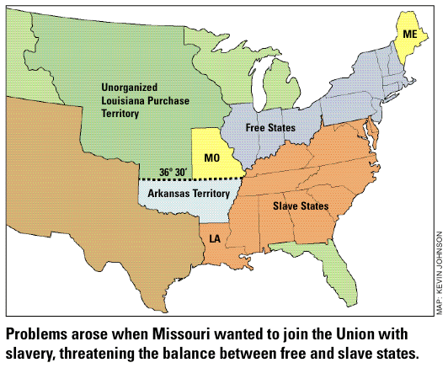
The Missouri Compromise (1820) 2
1819: Missouri (which allowed slavery) applied for statehood
US was balanced with 11 slave states, 11 free states
US agreed to admit Missouri as a slave state but also admitted Maine as a free state to keep balance
Congress also drew a line through Louisiana Territory – north of the line, no slavery; south of the line would allow slavery
Compromise driven by Henry Clay of Kentucky (War Hawk)

Slide 5
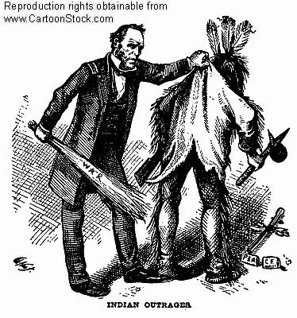
Indian Removal Act (1830) 3
Pres. Jackson wanted all Indians removed from the east and forced into the Great Plains
Most Native groups relented and moved west, but the Cherokee resisted

Slide 6
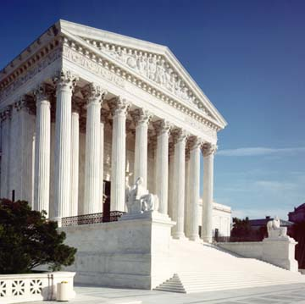
Worcester v. Georgia (1832) 5
Cherokee sued government
Supreme Court agreed that the Cherokee were a separate nation which the US had signed treaties with and were therefore not bound by state law
Pres. Jackson refused to enforce the court’s decision

Slide 7
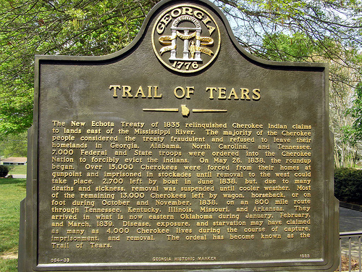
The Trail of Tears 6
Forced removal of the Cherokee, Creek, Seminole, and Choctaw nations from the east to the Indian Territory (Oklahoma)
46,000 Indians moved, thousands died along the way, especially among the Cherokee

Slide 8
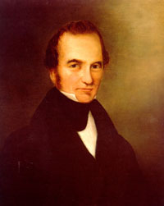
Stephen F. Austin 7
1793 – 1836
“Father of Texas”
Arrived in Texas in 1825 with large group of American settlers
Died of pneumonia while serving as first Sec. of State for the independent Republic of Texas

Slide 9
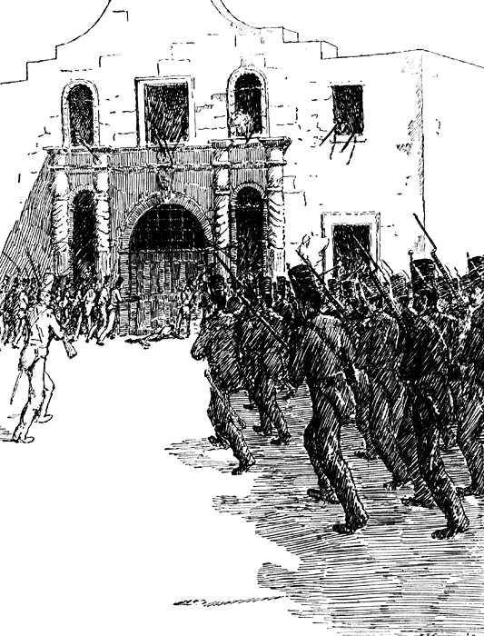
Battle of the Alamo 8
Feb. 1836
Around 200 Texans held off 6000 Mexican soldiers for 13 days before being wiped out – Mexican Gen. Santa Anna ordered no prisoners be taken
“Remember the Alamo!” becomes Texans battle cry

Slide 10
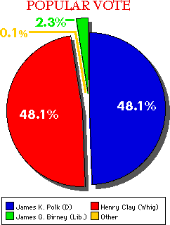
Election of 1844 12
Whig Party: Henry Clay
Democratic Party: James K. Polk
Polk promised to annex Texas, but balance it by also annexing the Oregon Territory in the north; he also promised to try to buy California from Mexico
Polk won

Slide 11
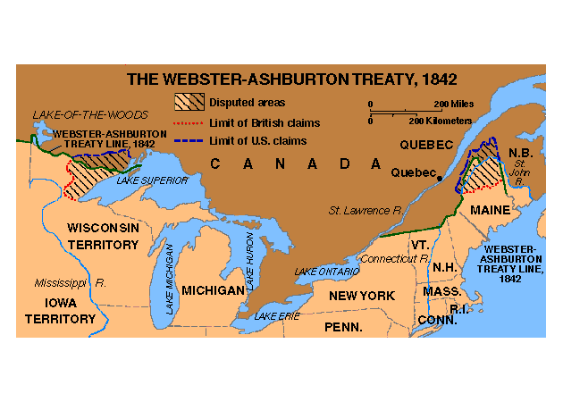
Webster-Ashburton Treaty (1842) 9
Settled dispute between US and Britain over the border between US and Canada from Maine to Minnesota

Slide 12
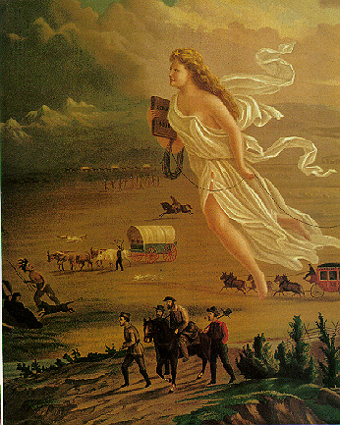
“Manifest Destiny”
Term coined by magazine editor John Louis O’Sullivan in 1845
Idea that Americans had been given North America by God, who wanted them to settle it all and push out Indians, Mexicans

Slide 13
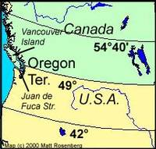
54-40 or Fight! 11

Slide 14
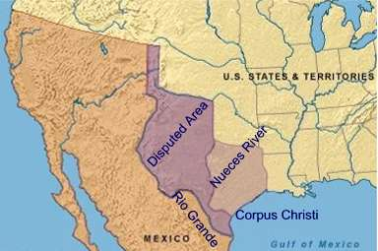
Texas annexed 13
1845: Texas admitted to the Union as a slave state
Mexico furious, broke off diplomatic relations with US
Dispute arose over where the southern border was between Texas and Mexico

Slide 15
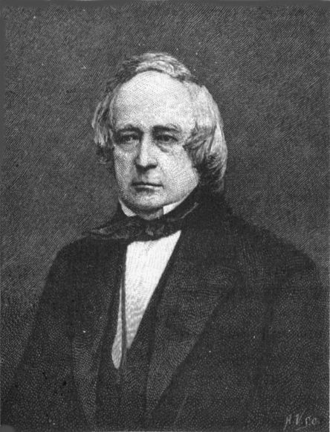
Polk tries to buy California
Polk sent an envoy, John Slidell, to Mexico City with an offer to purchase California
Mexicans refused to even meet with Slidell
All chances of a peaceful exchange died, US would go to war with Mexico

Slide 16
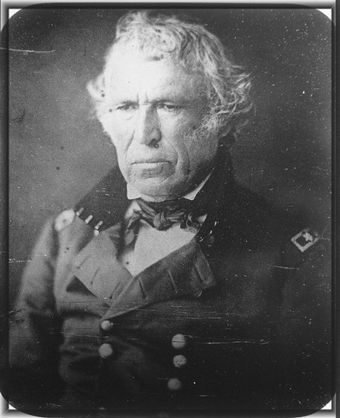
The Mexican War (1846-48) 15
Polk ordered US troops under Zachary Taylor to secure the Texas border
Mexico considered this an act of war, attacked US force
May 13, 1846: US declared war on Mexico

Slide 17
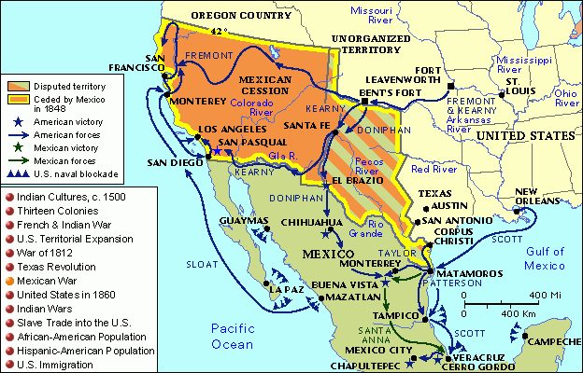
The Mexican War (1846-48)

Slide 18
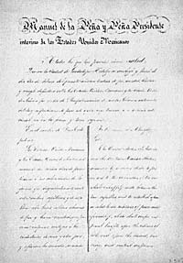
Treaty of Guadalupe-Hidalgo 16
Feb. 1848
Mexico surrendered after US forces captured Mexico City
Ended the Mexican War
Mexico ceded 500,000 sq. miles of territory (California, Utah, Arizona, Nevada, New Mexico)
Mexico accepted Rio Grande as southern border of Texas
In return, US paid Mexico $15 million and assumed $3.25 million in debts Mexico owed to US citizens

Slide 19
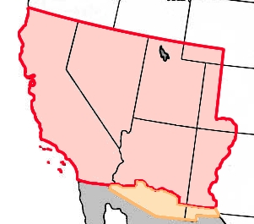
Mexican cession 17

Slide 20
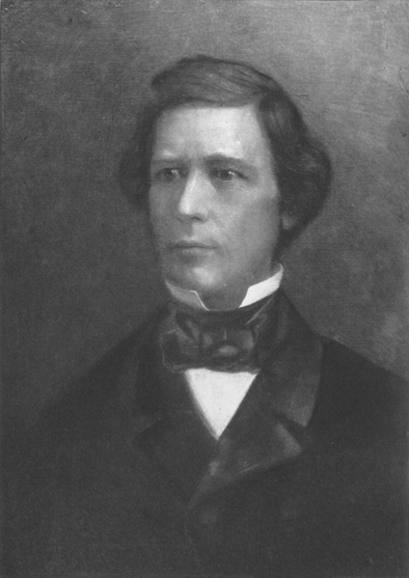
Wilmot Proviso 14
Proposal by Rep. David Wilmot that slavery not be allowed in any territories gained by the US from Mexico
Angered southerners, reopened slavery argument
Failed to pass the Senate

Slide 21
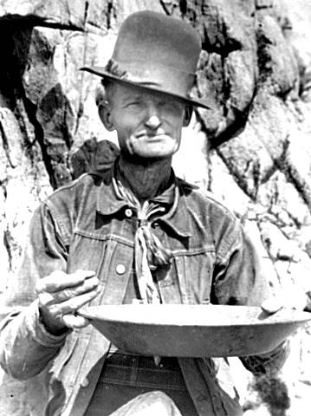
Gold Rush of 1849 18
Gold discovered in California in 1848
Surge of 80,000 new settlers flooded California (called ’49ers) over the next year, hoping to get rich quick
Growth in population led California to apply for statehood

Slide 22
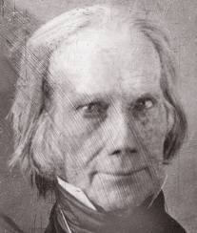
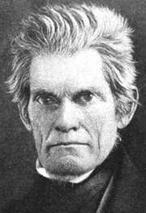
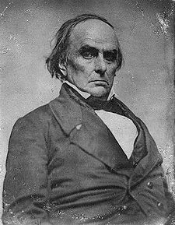
Compromise of 1850
If California joined as a free state, the balance in Congress would be upset
Henry Clay of KY proposed a series of compromises between North and South that would allow California to become a state
Plan was opposed by John C. Calhoun of SC, but backed by Daniel Webster of MA

Slide 23
Compromise of 1850
Northerners got:
California admitted as a free state
New Mexico won territory from Texas, limiting Texas’ size
Slave trade in Washington DC banned
Southerners got:
“popular sovereignty”: each future state would get to decide for itself on slavery
Texas’ debts to southerners would be paid by US gov’t
Slave ownership in Washington DC remained legal
Congress not allowed to interfere in domestic slave trade
Strong Fugitive slave laws allowed southerners to recover runaway slaves in the north

Slide 24
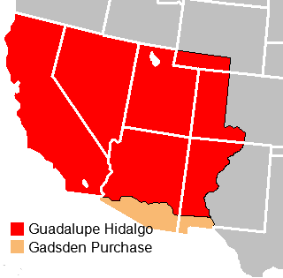
Gadsden Purchase 19
1853: US purchases 30,000 sq. mile strip of Mexico for $10 million
Land was needed to build a southern transcontinental railroad from New Orleans to California

