Slide 1
Unit 1: Foundations & Dev
3 Branches of Government

Slide 2


The 3 Branches of Government

Slide 3
Legislative Branch

Slide 4
House & Senate
House of Representatives
  Number determined by population
  Currently has 435 members
  Each represents a Congressional District
  Serve 2-year terms
  NC has 13 representatives
Senate
  Number equal for each state
  100 members = 2 per state
  Represent the state as a whole
  Serve 6 year terms

Slide 5
Requirements for Congress
House:
  At least 25 years old
  U.S. citizen for at least 7 years
  State resident
Senate
  At least 30 years old
  U.S. citizen for at least 9 years
  State resident

Slide 6
Congressional Sessions
Each new Congress is given a number to identify it
  1789: 1st Congress
Each term is divided into 2 sessions
  Run from January to late November/December
Special sessions can be called by President during times of crisis

Slide 7
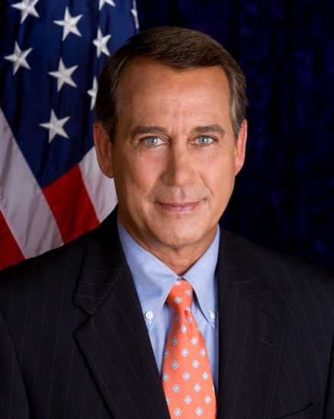
Leaders of Congress
Speaker of the House: leader of HoR
  Member of majority party
  Role: runs/organizes floor debates, influences others, tries to get laws passed that help his party
President of the Senate: Vice President
  Rarely attends Senate debates
  Only role is to vote in a tie

Slide 8
Leaders of Congress
President Pro Tempore
  Leader of Senate when VP isn’t there
  Member of the majority party
  Role is more ceremonial
Minority & Majority Leaders
  Leaders of the political parties found in each house
  Make sure laws are passed in the interest of their own party
Party Whips: Keep their political party in check
  Makes sure that members are showing up to vote

Slide 9
Committee System
Members of Congress are placed into committees that focus on one category to pass laws in
  Education
  Agriculture
Types of committees:
  Standing: permanent committee
  Select: limited amount of time
  Joint: includes members from both houses
  Conference: temporarily formed to help the House and Senate reach an agreement on a proposed bill

Slide 10
Seniority System
Members put in certain committees based on seniority
Leaders also look at expertise and loyalty to the party
Freshman
Junior
Senior
Sophomore

Slide 11
Powers of Congress
Expressed powers
Implied powers
Non-Legislative Powers: Not related to law-making
  Impeachment – accusing officials of misconduct through a trial
  Can propose amendments
  Approve/reject appointments
  Censure – punishing the President for inappropriate behavior (no real punishment)
  Immunity – makes a person or group free from otherwise legal obligations
    Congressmen cannot be sued

Slide 12
Executive Branch

Slide 13
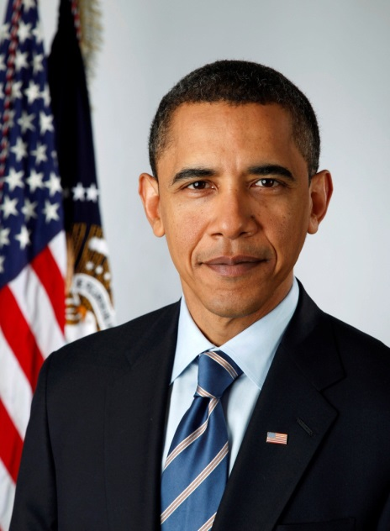
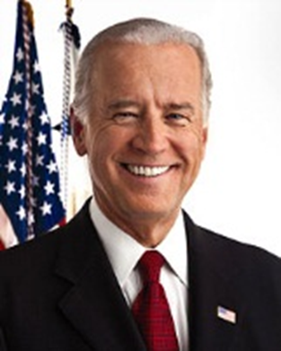
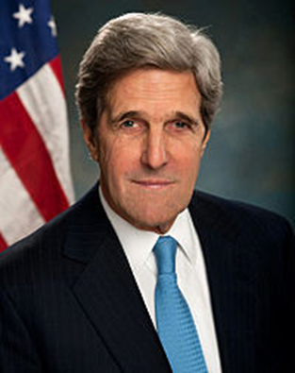
The Executive Branch
President
Vice President
Cabinet
  15 executive departments
  Advisors
  Most recent addition was Dept of Homeland Security (2002)

Slide 14




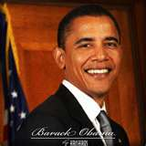
EXECUTIVE BRANCH
PRESIDENT: PURPOSE – ENFORCE THE LAW
ROLES OF THE PRESIDENT
Chief Executive
Commander-in-Chief
Legislative Leader
Judicial Leader
Chief of State
Foreign Policy Maker
QUALIFICATIONS
35 years old
Natural born citizen
Resident of US for at least 14 years

Slide 15
Powers of the President
Give State of the Union address every January
Give Executive Orders—rule or command that has the force of law
Appoint Judges, Cabinet Members, and Ambassadors
Send troops into battle
Grant Pardons—declaration of forgiveness and freedom from punishment
Grant Reprieves—delay of punishment until a higher court can hear the case
Grant Amnesty—give a pardon to a group of people

Slide 16
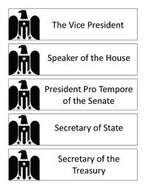
Succession
Top 4 after V.P.
  Speaker of the House
  President Pro Tempore
  Secretary of State
  Secretary of Treasury

Slide 17
Judicial Branch

Slide 18
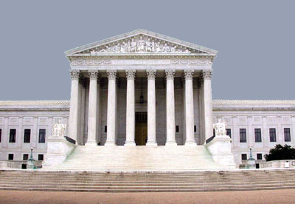
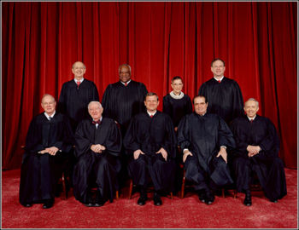
JUDICIAL BRANCH
SUPREME COURT – PURPOSE – INTERPRET THE LAW
SUPREME COURT
9 Justices (8 & 1 chief) – Appointed by the President
Justices serve life terms.
Supreme Court oversees actions of Congress & President.
Court uses Constitution to make sure govt actions are Constitutional

Slide 19
Powers of the Court
Judicial Review
  Power to say whether or not a law is constitutional
  Established by Supreme Court case in 1803
    Marbury v. Madison

Slide 20


Checks and Balances
President Congress
  President can veto (reject) laws made by Congress
    President has veto power
Congress President
  Congress can override presidential veto & pass a law that has been rejected by the pres
    Requires 2/3 majority in both Senate and the House

Slide 21
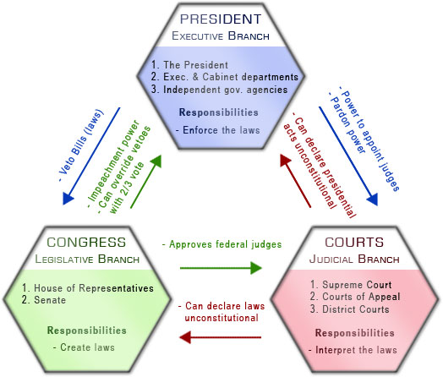
Checks and Balances

