Slide 1
Unit 1: Foundations & Development
Creating the Constitution

Slide 2
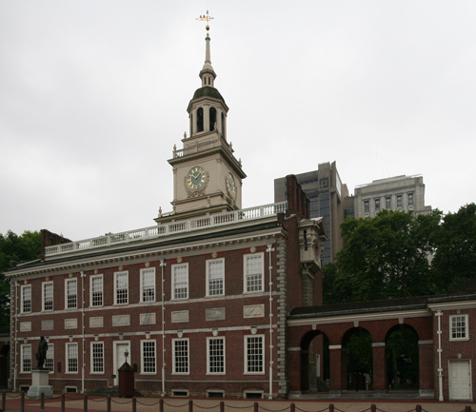
The Constitutional Convention
Also called the Philadelphia Convention because it was held in Philadelphia(1787)
Purpose = to fix the Articles
Each of 13 states would send delegates to Philadelphia
55 delegates

Slide 3
The Constitutional Convention
Rhode Island didn’t attend
wanted control of their own state
They were influenced by British principles & thinkers:
Magna Carta, British Parliament, Mayflower Compact, English Bill of Rights, The Enlightenment and its thinkers (John Locke, Thomas Hobbes, Jean-Jacques Rousseau)

Slide 4
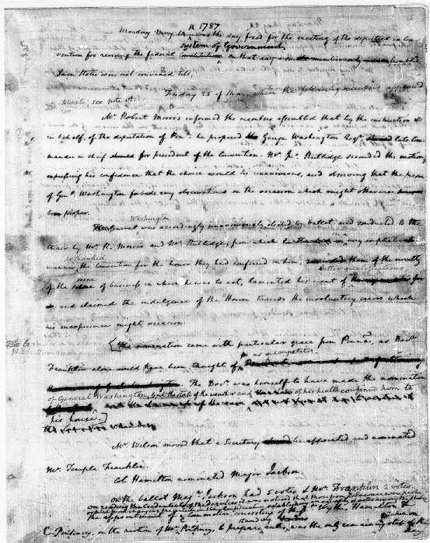
The Constitutional Convention
Delegates kept meetings secret
Didn’t want pressure or public interferrence
We know what happened b/c James Madison kept a diary
sometimes called the Father of the Constitution

Slide 5
The Constitutional Convention
Initial goal was to revise the AoC
Realize wasn’t going to work
Threw out AoC
Decided new constitution needed to be written to strengthen the government

Slide 6
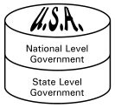
Writing the Constitution
Framers estab sys of govt called federalism
Divides govt’s powers btwn national government and state government
Delegates wanted diff things under federal sys
The Great Compromise:
Congress = 2 houses
Senate - equal representation
House of Representatives - based on state population

Slide 7
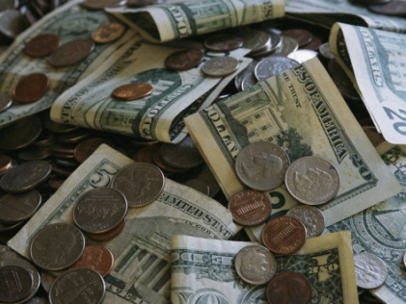
Government Becomes Stronger
Constitution gave national govt more power:
Power to coin & print money; set taxes
Raise armed forces
Regulate trade within states and with other countries
A president will carry out nation’s laws
Created Supreme Court to interpret laws

Slide 8
Government Becomes Stronger
Constitution completed September 1787
39 of 42 delegates that were present signed the constitution
Needed to be ratified in order to become law
9 of 13 states needed to ratify/make law
Ratification = approval

Slide 9
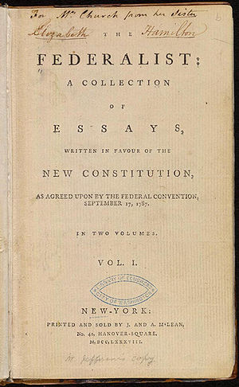
Approval of the Constitution
Ppl took sides & tried to persuade others
Federalists – strong supporters of the Constitution & a strong national government
Thought needed to keep country unified
Alexander Hamilton, John Jay, James Madison
Created the Federalist Papers to gain support
Paper #10 : “A Republic, by which I mean a Government in which the scheme of representation takes place . . . Promises the cure for which we are seeking . . . .” - James Madison

Slide 10
Approval of the Constitution
Antifederalists – people who opposed the Constitution & new system of government
Thought it went against what they fought for in the war
Didn’t think would protect states’ power or personal freedom
Federalists gained support but ppl wanted something that listed their rights
States suggested that a bill of rights be added if Constitution was ratified

Slide 11
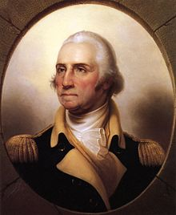
Approval of the Constitution
Most states ratified in 1787 & 1788
NC & RI didn’t approve until after already in effect
New US govt began operating in March 1789
Washington sworn in as 1st president April 30, 1789

