Slide 1
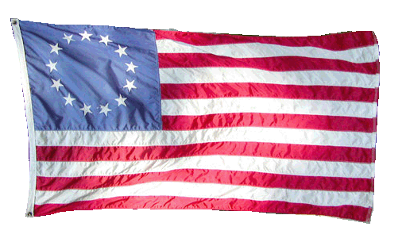
The Road to Revolution…
What do the 13 stars and stripes on this flag represent?

Slide 2
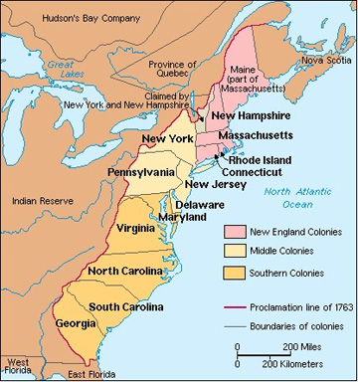
13 Colonies

Slide 3
Life in the colonies…
Colonies experienced considerable freedom before the American Revolution.
However, England did place some restrictions on the colonies such as:
trade
$$$ taxes

Slide 4
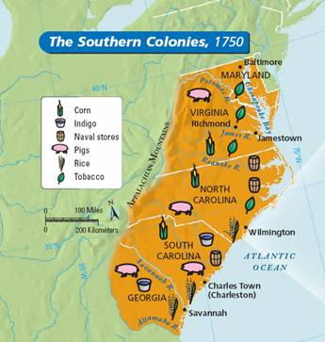
Restricting the colonies…
What is mercantilism?
Mercantilism is the idea that a country should sell more goods to other countries than it buys.
13 colonies

Slide 5
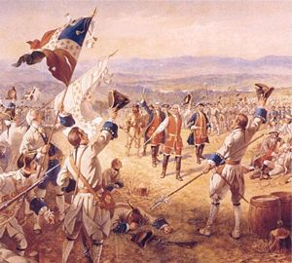
England goes in DEBT!
French and Indian War
Who? England, France, Indians
Why? Gain territory
Where? North America
When? 1754-1763
Result? England defeats France

Slide 6
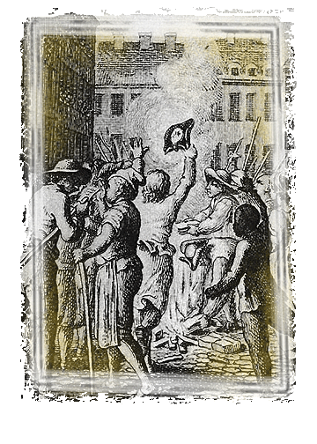
England has to find more $$$
Question:
How does England pay off the debt from the war?
Answer:
England creates higher taxes.
Stamp Act (1765):
Required colonists to attach expensive tax stamps to all newspapers and legal documents.

Slide 7
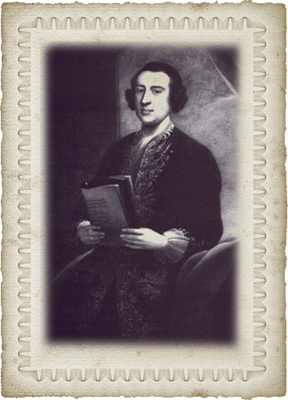
More restrictions…
Townshend Acts (1767):
New taxes on items sent to the colonies such as:
- glass
- tea
- paper
- lead

Slide 8
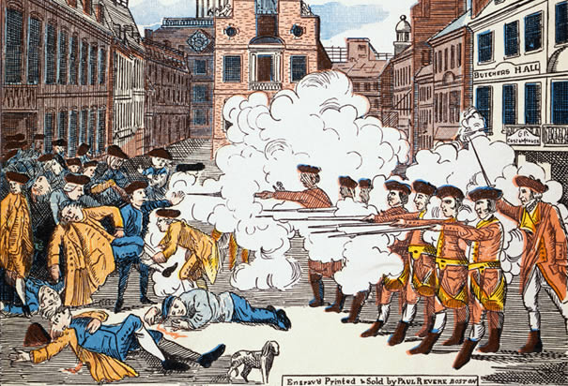
Boston Massacre
March 5, 1770: colonists threw snowballs at British guard
British officers/soldiers gathered as reinforcements
Actual accounts are unknown
Someone yelled “FIRE!” – British soldiers fired into crowd
5 people died & colonists named it the Boston Massacre

Slide 9
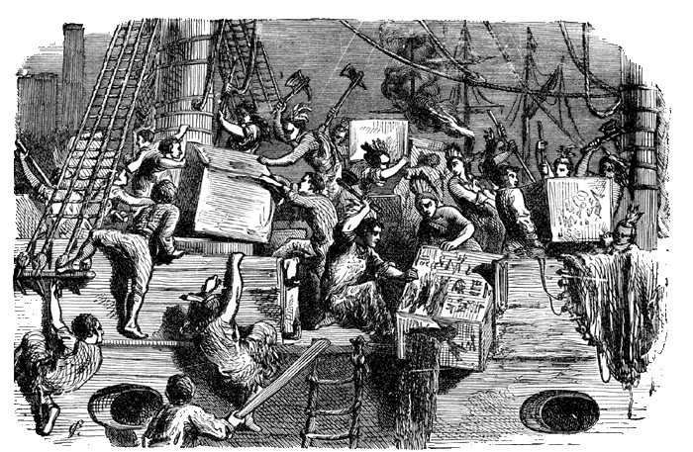
More restrictions…
Tea Acts (1773):
Allowed England to sell tea much cheaper than colonial sellers, essentially bypassing them and making more a profit.

Slide 10
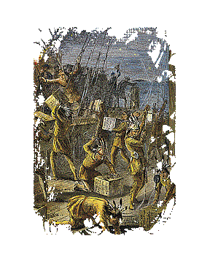
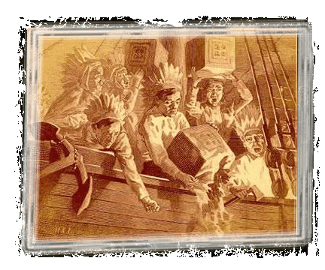
Boston Tea Party
The colonists decided to revolt against the English for imposing taxes that they viewed as unfair.

Slide 11
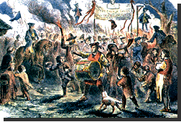
How do the British react?
MORE RESTRICTIONS!
Intolerable/Coercive Acts:
No longer a right to trial by jury
Allowed British soldiers to search and even move into the colonists’ homes

Slide 12
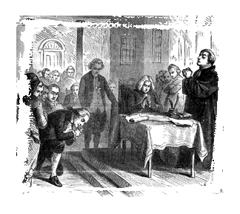
Moving toward Independence!
Delegates also known as representatives are sent from the colonies to meet in Philadelphia.
Why?
To create a group to represent American interests and challenge England.

Slide 13
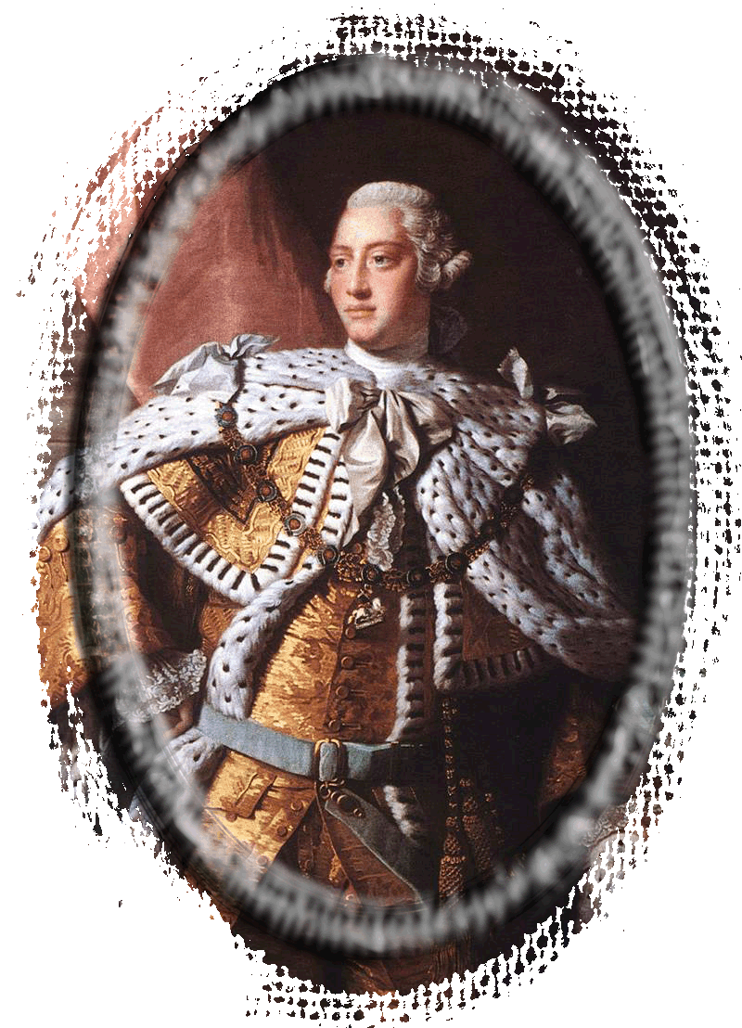
The First Continental Congress
Sept 1774 in Philadelphia
56 delegates; Georgia not represented
Appeal to King George III
10 things they wanted
England responds with FORCE!
Two battles erupt between the British and colonists as a result.

Slide 14
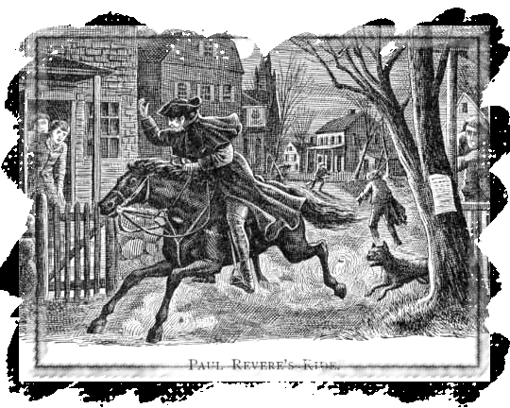
Lexington and Concord
1775 – colonists created militias called minutemen
Colonists stock piled weapons in Concord, Massachusetts.
Nearly 800 British soldiers march to Concord as a result.
Eventually retreated to Boston; never found weapons
“The British are coming!” – Paul Revere

Slide 15
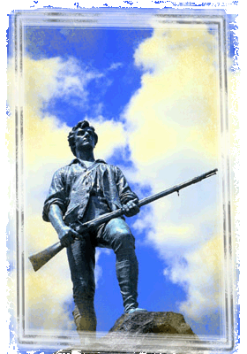
Reluctant Revolutionaries
“Stand your ground, don’t fire unless fired upon. But if they mean to have a war, let it begin here!”
Captain Parker

Slide 16
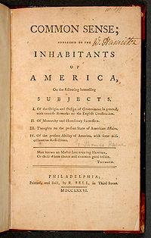
The Second Continental Congress
1775 in Philadelphia
Only 12 of 13 colonies
Met to plan the overthrow of England because they felt the natural rights of people had been violated
Created Continental Army
Common Sense by Thomas Paine (1776)
Promoted independence from England
June 7, 1776 – committee formed to create a declaration of independence

