Slide 1
Unit 1: Foundations & Development
Colonial North America

Slide 2
Types of Colonial Government
Royal – run by the King
Proprietary – given by King for one person to run
Joint-Stock – owned and run by investors
Self-governing – started and run by themselves

Slide 3
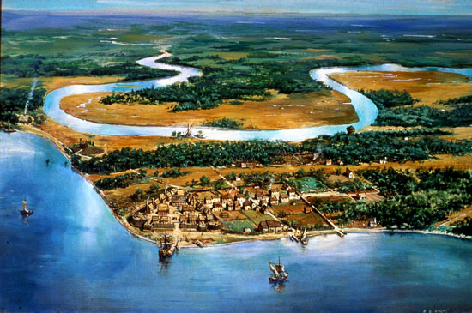
Jamestown
Established in 1607
First permanent English settlement
Was a joint-stock colony, made profit from tobacco
In present day Virginia

Slide 4
Religious Dissenters
Pilgrims – built settlement called Plymouth in 1620 in modern day Massachusetts.
Wanted to separate from church of England
Quakers – persecuted for their beliefs
Pacifists (against war); settled Pennsylvania
Catholics – members of original Christian church & persecuted in England
Founded Maryland
Puritans – wanted to purify Church of England
Settled in Massachusetts
Famous for their persecution of “witches” during the Salem Witch Trials of the 1600s

Slide 5
Colonial Economy
Mercantilism—theory that a country should sell more goods than it buys
Gave Britain a favorable balance of trade (they made money)
Strain on colonies, only sell cheap raw goods to Britain whereas they buy only expensive products
Plantation system—large farm in which slave labor or other workers are used to grow a cash crop
Indentured servants were the other workers, people contracted to work for a certain period of time in return for travel expenses, shelter, and food

Slide 6
New England Colonies
Massachusetts, Connecticut, Rhode Island, New Hampshire.
Mostly Puritan
Farming difficult
Made a living by fishing and trade

Slide 7
Middle Colonies
New York, New Jersey, Pennsylvania, Delaware
Rich soil
Expand Trade
DIVERSE
Many different religions and professions

Slide 8
Southern Colonies
Maryland, Virginia, North Carolina, South Carolina, Georgia
Very hot, humid
Good crops
Plantations
More religious toleration

Slide 9
Slavery
Favored over indentured servants
Brought from Africa to America on the Middle Passage of the Triangular Trade Route
Africa (slaves)
America/Caribbean (rum, sugar, cotton, raw materials)
England (manufactured goods)
Draw a diagram of the triangular trade route in your notes

Slide 10
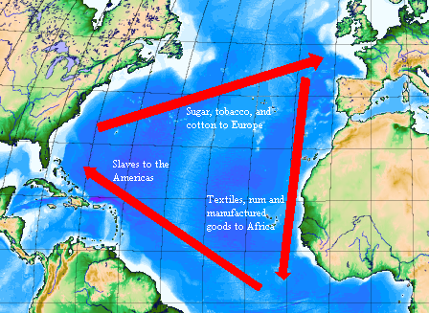

Slide 11
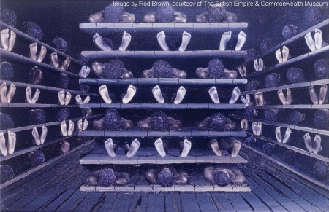

Slide 12
Native Americans
Already in America, many were killed off by disease
Numbers too small to fight off Europeans
Many deaths also occurred due to conflicts, population plummeted
Although there was violence, some groups were able to coexist peacefully…at least for a little while

Slide 13
Bacon’s Rebellion
Native Americans seen as a threat
Nathaniel Bacon, a farmer, reacted to his hatred of N.A. in 1676
He raised an army of farmers on the Virginia frontier to fight them
Successful on the frontier—but still mad
He marched his men to Jamestown to confront officials about lack of representation in the frontier and unfair high taxes
He and his men set fire to the town and almost completely destroyed it

