Slide 1
Unit 10: Personal Finance
Banks & Banking

Slide 2
Origins
Goldsmiths gave ppl loans; promised to pay by certain date with interest
Ppl used property/things to guarantee repayment
These properties/things = collateral

Slide 3
The Banking System
Different types of bank accounts
Checking account
Demand deposit – bank must give you your $
Savings account - your $ earns interest
Time deposit – bank requires $ in acct for certain time
Certificates of deposit (CDs) – longer time deposit accounts
Money market – maintain minimum balance & get higher interest rate

Slide 4
The Banking System
4 main types of banks
Commercial banks – most banks in US
Lots of services (accts, loans, credit cards…)
$ insured by government agency (Federal Deposit Insurance Corporation – FDIC)
Insured up to $100,000
Savings banks – started 1800s for saving
Different services including home loans
Insured by FDIC

Slide 5
The Banking System
Savings & Loan Associations – S&Ls
Mid 1800s for home buyers
Lots of home mortgages today
Expanded to other services
S&L crisis in 1980s
Credit Unions – est. for certain comp/org
Owned/operated by members
Deposits = buying interest paying shares
$ insured by National Credit Union Association (NCUA) – up to $100,000

Slide 6
The Federal Reserve System
Called the Fed – set up 1913
Created to stop bank failures due to running out of money & regulate banks
banks must keep certain amt of $ in reserve
US divided into 12 federal districts w/ Federal Reserve bank in each
Fed banks work only with govt & other banks

Slide 7
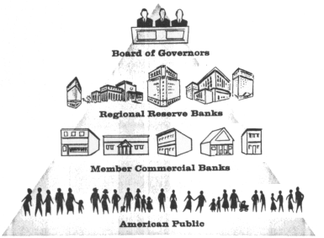
The Federal Reserve System
Purpose – government banking & control nation’s $ supply
7-member board of governors in D.C.
Appointed by president / approved by Senate
Serves 14 years

