Slide 1
Jefferson’s Presidency
Main Idea
The rise of political parties influenced the election of 1800, bringing Thomas Jefferson and a new outlook to the presidency.

Slide 2
The Election of 1800 12
Democratic-Republican Thomas Jefferson
Federalist John Adams
The campaign was vicious.
Supporters of each side made their arguments in letters and newspaper editorials

Slide 3
The Election of 1800
Federalists claimed that
Jefferson was pro-French.
Jefferson wanted to destroy organized religion
Democratic-Republicans claimed that
Adams wanted to crown himself king.
The Federalists would try to limit Americans’ rights (using the Alien and Sedition Acts as proof of their claims).

Slide 4
The Election of 1800
Problems
Jefferson and Burr Tied.
Political parties did not specify who was the candidate for president.
The House of Rep. was tied for 35 votes.
Hamilton urged Federalists to support Jefferson. On the 36th vote, Jefferson was chosen president.
Twelfth Amendment (1804), which said that electors must cast separate ballots for president and vice president.

Slide 5
The Louisiana Purchase 15
Jefferson sent James Monroe to Paris to try to purchase New Orleans and West Florida.
At the meeting, France offered to sell the United States all of the vast Louisiana Territory.
On April 30, 1803, they signed an agreement with France to buy the land—final price about 80 million francs, or $15 million

Slide 6
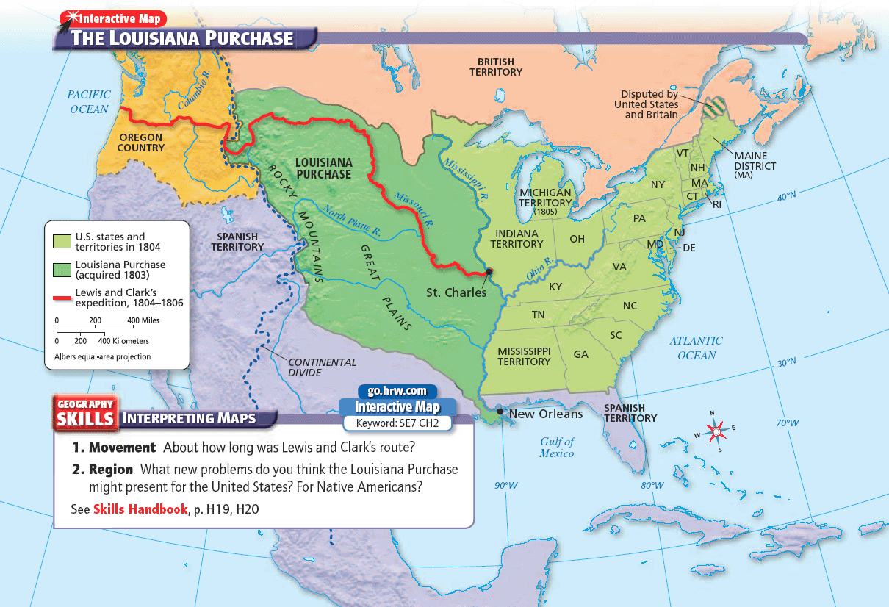

Slide 7
The Constitution did not directly give Jefferson the authority to buy new territory for the nation. (Strict Construction)
Jefferson and his fellow strict constructionists decided that the right to acquire territory was implicit in the president’s constitutional power to make treaties.

Slide 8
The Louisiana Purchase
Lewis and Clark expedition, to explore the land of the Louisiana Purchase.
Led by Meriwether Lewis, Jefferson’s secretary, and William Clark, an experienced frontiersman
They mapped the country and surveyed its natural history, including plants, animals, and landforms.
Were helped by their guide, a Shoshone woman, Sacagawea

Slide 10
The Role of the Supreme Court Changes
Judiciary Act of 1801, created new positions in the judicial branch.
Departing President John Adams hurried to fill them with Federalists on his last day “Midnight Appointments” 11
Not all letters were delivered before Jefferson took office the next day.
James Madison, the new secretary of state, refused to deliver the remaining commissions.

Slide 11
The Role of the Supreme Court Changes
William Marbury, did not receive his commission
He claimed that the Judiciary Act of 1789 gave the Court the power to force Madison to deliver the commission.
The Constitution did not give the Court the power to force Madison to deliver Marbury’s commission.
It ruled the Judiciary Act of 1789 unconstitutional.
Marbury v. Madison established judicial review, to declare that a law violates the Constitution.13

