Slide 1
Unit 7: Economics and Choices
The Economic System at Work

Slide 2
Economic Systems
Economics = study of how we make decisions in a world w/ limited resources
System society uses to produce & distribute goods/services
Econ systems needed & vary all over world
Want-satisfaction chain = goods/services to satisfy wants
Competition = main factor in setting prices

Slide 3
Types of Economic Systems
Traditional Economy – based on traditions, culture, history
Grow / make own goods to survive
Barter system / trade
Common in undeveloped countries
Command Economy – government makes all decisions
Govt owns all factors of production & natural resources
Communist govts (Cuba & N. Korea)

Slide 4
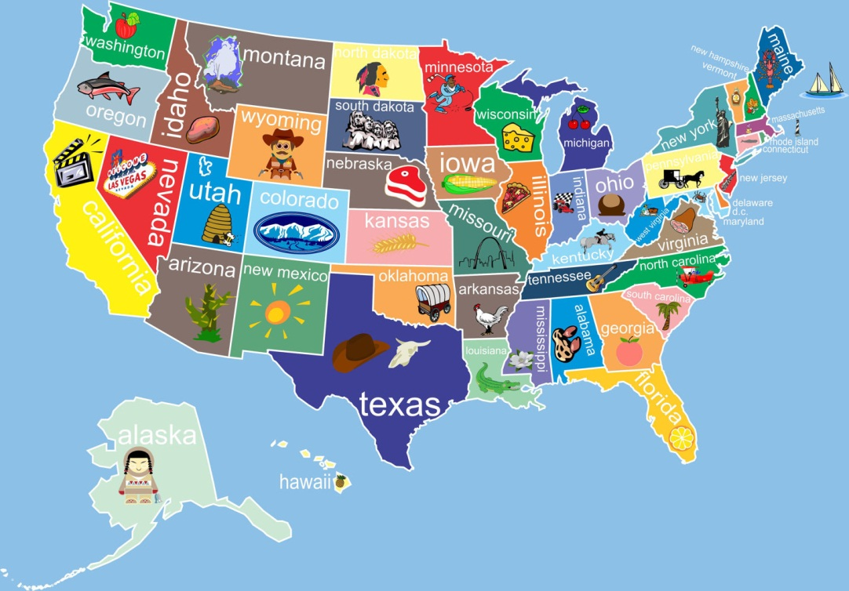
Types of Economic Systems
Market Economy – decisions made by individuals
Personal needs/interests put 1st
Based on freedoms & rights
Little/no govt interference or regulation
Free market – right to buy & sell goods as you choose
Most countries

Slide 5
Market Economy
Based on 5 American economic freedoms
Freedom to compete
Freedom to own property
Freedom to buy & sell
Freedom of workers to compete for jobs
Freedom to earn profits
Desire to make profit – $ left after expenses – is essential for market economy
Competition for resources

Slide 6
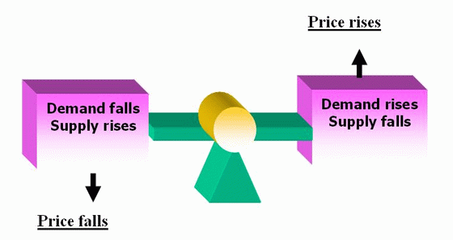
Market Economy
Supply & Demand:
Most basic of all economic principals
Usually lead to price changes
Law of supply – if price goes up, supply goes up; if price goes down, supply goes down
Law of demand – if price goes up, demand goes down; if price goes down, demand goes up
Want to reach a balance or equilibrium price

Slide 7
Market Economy
Free enterprise: bus. operate w/ little govt interference
No limit on profits / no success guarantee
Competition important for low prices, high quality
Innovation – new ideas
Patent – exclusive rights to sell invention for certain time
Copyright – exclusive right to publish/sell writing, art, music
Capitalism: productive resources privately owned
Driving force of American economy
Encourages $ investment for financial gain
Freedom to buy/sell as you please
Benefits society as a whole

Slide 8
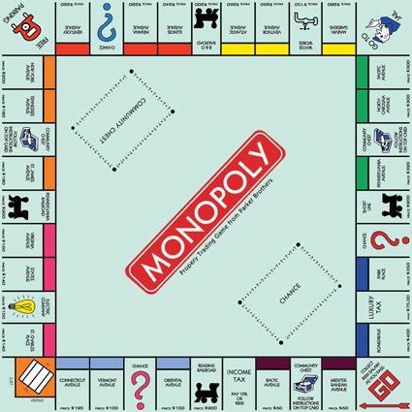
Market Economy
Monopolies: only 1 company selling product/service
Usually banned in most market economy countries
Price fixing or gouging can happen
Quality control is problem
Natural monopolies are legal – certain public utilities

Slide 9
U.S. Economic System
Mixed economy – combines elements of different economic systems
Businesses have freedom, but have certain regulations to meet
Ex: minimum wage laws, discrimination laws
American business
Large businesses came about in late 1800s
Big business essential to American economy
Big businesses join together = conglomerates

