Slide 1
Goal 1: The New Nation

Slide 2
I. George Washington
First President
1789 - 1797

Slide 4
A. Washington Takes Office:
Unanimously elected
Had no desire to be President – saw it as a duty
No political Party affiliation
VP – John Adams (Federalist)
Problems – 1. Huge war debt
2. No permanent capitol (NY temporarily)
3. Federal government = Only Pres, VP, and Congress

Slide 5
B. Washington’s Cabinet:
Cabinet
Attorney General:
Edmund Randolph
Secretary of War:
Henry Knox
Secretary of State:
Thomas Jefferson
Secretary of
Treasury:
Alexander Hamilton

Slide 6
C. The Judicial Branch:
The Judiciary Act of 1789:
1. Established a national court system
2. The Supreme Court would settle disputes between federal government and states

Slide 7
D. Hamilton’s Financial Plan:
Establish a National Bank:
- Funded federally 20% and private investors 80%
- Issues paper money
- Madison and others argued this would create an alliance between the federal government and the wealthy
Pay off National Debt:
- Assume the debts of states (South disagreed – agreed if the capitol was put in the south (Washington DC))
- 25% excise tax on whiskey

Slide 8
E. Hamilton v. Jefferson
Jefferson | Hamilton

Slide 17
F. 1st 2 Political Parties:
Federalists:
Democratic-Republicans:

Slide 18
G. The Whiskey Rebellion: 6
Cause: Congress passed an excise (tax)
on whiskey.
Effected: The farmers were greatly effected.
Reaction: 1. Angered farmers
2. Washington: Sends the militia to put down the rebellion
Significance: Shows that the Federal Government will use force to put down those resisting the law; STRONG central government

Slide 19
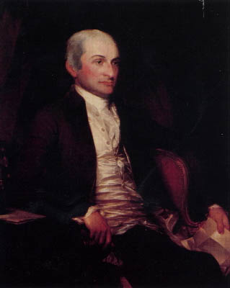
Foreign Policy
Jay’s Treaty 1794 22
Avoid war with Britain
Removed British forts in NW Territory (fur trading in the area)
Did not solve the problem of shipping rights in British territory

Slide 20
Foreign Policy Con’t
Pinckney’s Treaty 1795 23
With Spain
US gained land West of the Mississippi
31st Parallel became Florida border
Mississippi River open to trade
*New Orleans Port open for American use

Slide 22
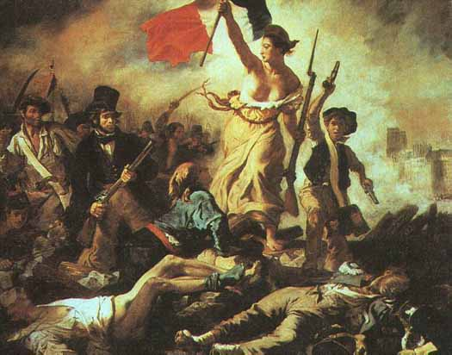
The French Revolution
Americans proclaim NEUTRALITY

Slide 23
Native Americans
Settlers are beginning to move West and thought the land was in their control which led to confrontation with Native Americans
Native Americans were defeated by Anthony Wayne at The Battle of Fallen Timbers
Treaty of Greenville: Land ownership in West for American settlers; ended hostilities in present day Ohio with Native Americans 19

Slide 24
Washington’s Farewell Address
First appeared in a Philadelphia Newspaper
1o days later, published in The Independent Chronicle, a newspaper, September 26, 1796
Never delivered orally
Warned against
Political Parties
Alliances with other countries

Slide 25
Washington’s Precedents
Cabinet
Serve two terms

Slide 26
John Adams Administration 1797-1801
Election of 1796
Federalist: John Adams
Republicans: Thomas Jefferson
Adams wins and Jefferson becomes VP

Slide 28
XYZ Affair 25
France upset over Jay’s treaty, U.S send diplomats to France to talk
Turned the men away
France wanted $250,000 from the US to meet, not negotiate with French Foreign Minister Tallyrand
America insulted and angry

Slide 29
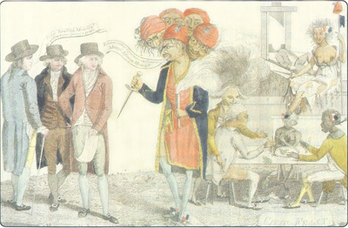

Slide 30
Alien and Sedition Acts 9
Raised the US citizenship requirements from 5 years to 14 years
Allowed the President of the US to jail or deport “undesirable” aliens
Forbade people to speak out against the government
Set fines and jail terms for people considered to be damaging to the government

Slide 31
Virginia and Kentucky Resolutions 10
Written by Jefferson and Madison
Virginia and Kentucky claimed the Alien and Sedition Acts “null and void”, because they violated the Bill of Rights (1st amendment)
Unconstitutional!
Very strict interpretation of the Constitution

Slide 32
The Bill of Rights 5
Federalists had promised a Bill of Rights to be added to the Constitution
This document would protect the rights of individuals
James Madison drafted the Bill of Rights
Based on writings of George Mason and Thomas Jefferson
Congress created amendments, the States had to ratify them
Congress agreed on 12 amendments, but only 10 were approved

Slide 33
Thomas Jefferson’s Administration 1801-1809
The Convention of 1800 26
Also known as the Treaty of Mortefontaine
Between the United States and France to settle the Quasi-War.
Meant the end of American foreign alliances

Slide 34
Election of 1800
Republican: Thomas Jefferson
Vice President was Aaron Burr
Goal: to reduce the national government’s size and power
Federalist: John Adams, had become unpopular due to the Alien and Sedition Acts

Slide 35
Election of 1800
Election was tied
Tie had to be broken by the House
12th Amendment: a separate vote must me cast for President and Vice President

Slide 36
Jefferson as President
Tried to distance himself from the lifestyles of the former Presidents
Rode horses instead of using carriages
Had intimate gatherings rather than lavish parties
Tried to pay off the National Debt, Decrease the size of the Federal Government, and wanted a militia rather than a standing army

Slide 37
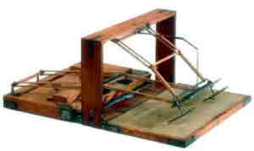
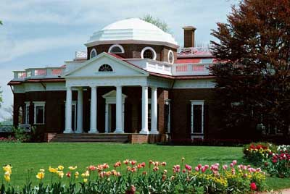

Slide 38
Jefferson and the Courts
John Marshall was the Chief Justice of the US Supreme Court
Marshall increased the power of the Supreme Court and the Federal Government
Jefferson claimed that Adams had “packed the court”
Midnight Judges: The Adams administration enacted the Judicial Act of 1801

Slide 39
Marbury v. Madison 1803 13
Established Judicial Review
means that the Supreme Court can declare acts of Congress unconstitutional and say what the law is

Slide 40
Alexander Hamilton and Aaron Burr

Slide 41
The Louisiana Purchase 1803
Sold to Jefferson and the USA for 15 million dollars (3 cents an acre)
Is this allowed in the Consitution?
USA doubled in size
Meriweather Lewis and William Clark sent to explore with Sacajawea as their guide

Slide 43
Election of 1808
James Madison: Democratic-Republican WON
Charles Pinckney: Federalist

Slide 44
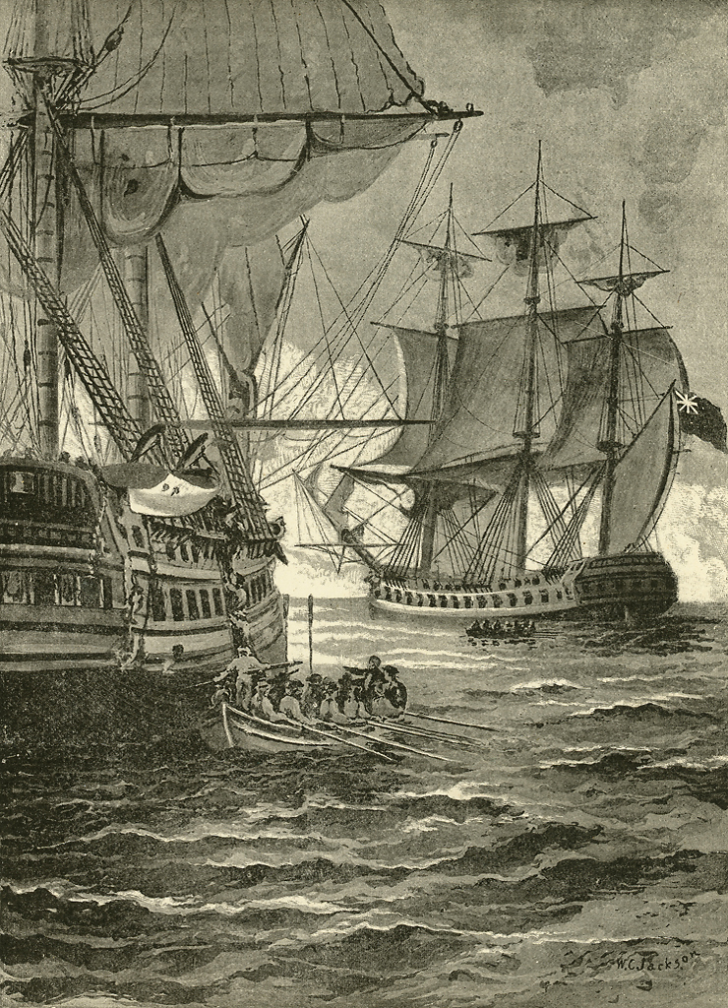
The War of 1812 29
Causes:
Britain blockaded France
Impressment
The Chesapeake Incident
The Embargo Act of 1807

Slide 45
War Hawks 29
Young Congressmen from the South and the West
John C. Calhoun: SC
Henry Clay: Speaker of the House
Wanted to expand further West

Slide 46
WAR BREAKS OUT…
President James Madison declares war
Battle of Tippecanoe
1814: Siege of Washington, D.C.
Dolly Madison
Fort McHenry, Francis Scott Key, and the Star Spangled Banner
Treaty of Ghent 31
December 1814 declared an armistice

Slide 47
The Hartford Convention
December 15, 1814-January 4, 1815
Hartford, CT
Secession brought up for the first time
Disbandment of the Federalist Party

Slide 48
The Battle of New Orleans 30
January 1815
Won by General Andrew Jackson “Old Hickory”
Fought and won after the Treaty of Ghent was signed
Made Jackson famous

Slide 49
Results of the War of 1812
Increase in National Pride
Increase in Western migration due to less Indian resistance
Increase in manufacturing
US Merchant Marines were almost destroyed
Snug Harbor
True Independence

