Slide 1
George Washington’s Presidency

Slide 2
February 1789
Washington elected president
John Adams vice president.
1st Cabinet
Secretary of State: Thomas Jefferson
Secretary of Treasury: Alexander Hamilton
Secretary of War: Henry Knox

Slide 3
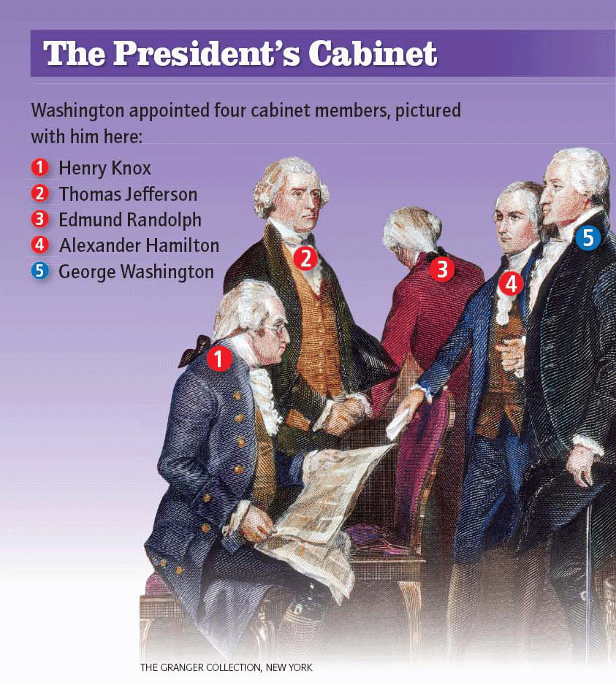
Washington’s Cabinet

Slide 4
The First Congress
Sent proposed amendments to the states (Bill of Rights) 5
The Judiciary Act of 1789 organized the judicial branch. 2
Writ of Mandamus- power to give orders to other Branches of Gov.- see Marbury V. Madison

Slide 5
1st Political Parties
Federalists:8
A. Hamilton
wanted a strong central government
Democratic Republicans: 7
T. Jefferson and J. Madison
Wanted a smaller central government with powerful states

Slide 6
Hamilton’s Economic Plan 3
Federal government should pay debt from the war
Create Taxes to pay for Debt
Establish national bank to control credit
New taxes
Tariff of 1789 taxed imported goods
Excise tax, 1791, taxed the production or sale of liquor, sugar, snuff, and carriages

Slide 7
Debating a National Bank
Two views of the Constitution:
Strict construction: the government should do only what the Constitution states 1
Loose construction: the government can take reasonable actions that are not outlined in the Constitution. 1
Hamilton pointed to the “necessary and proper.”

Slide 8
Compromise
Hamilton compromised with Jefferson
The capital would be moved to the South by 1800. (Washington D.C.)
the southerners in congress would allow Hamilton’s debt bill to pass.

Slide 9
Debating a National Bank
Jefferson strict Constructionist.
Wanted smaller national government.
South already paid their debt
Strict constructionist- Felt the National Bank was unconstitutional due to it not appearing in the Constitution
Bank of the United States began February 1791.

Slide 10
Washington’s Farewell Address 24
Washington warned against
involved in European Affairs
No Permanent alliances with other countries
No Political Parties
Avoid sectionalism

